Slide 1
Materials development and characterization
Prof Glikeria Kakali, NTUA

Slide 2
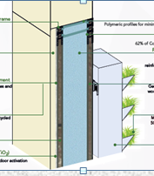
Objectives:
exploit CDW streams as raw materials, constituents, reinforcing/functional agents in GI panel
improve the performance of GI layers through the incorporation of CDWs
characterize CDWs and final products
10 CDWs were used for developing 11 products to be incorporated in GI panel
plastics
textiles
wood
bricks
glass
EPS
PU
concrete
cement
Al/stainless steel scrap
wood fibers
plastic fibers
textile fibers
geopolymer
insulation layer
MOC
PCMs aggregates
adhesive
Al frame
green wall cassette
plant substrate
Involved partners: NRGIA, LEITAT, CID, UBRUN, NTUA, COLL, ALCN, Cnano

Slide 3
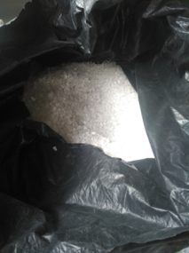
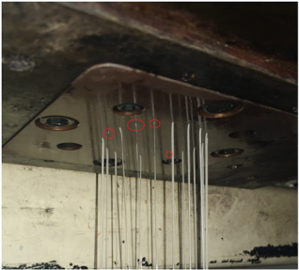
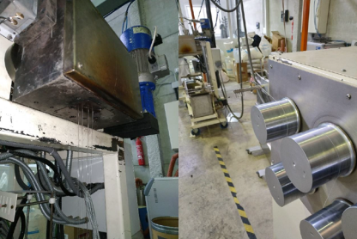
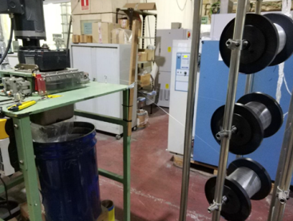
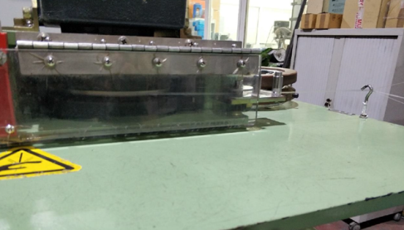
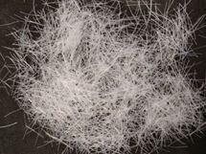
PE Fibers
Processing
Processing (addition of plasticizer)
Extrusion
Pellets from CDW
Spinning
Cutting
PE fibers
8.5 kg
Properties
Length (mm) | 6-12
Aver. Diameter (μm) | 59.4
Density (g/cm³) | 0.97
Tensile Modulus (MPa) | 258.60
geopolymer layer
(UBRUN/NTUA)

Slide 4
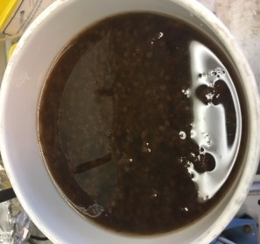
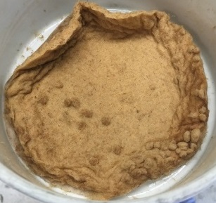
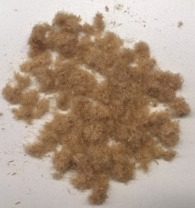
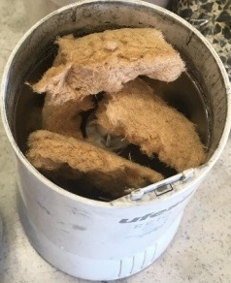
Wood Fibers
Processing
1
2
3
4
5
Hydrothermal treatment
(95ºC, 30 min)
Filtration and washing
Dried (60ºC overnight)
Obtaining individual fine fibers by mechanical treatment
Morphological analysis
MDF chips
MDF pulp
MDF fibers dried
Fiber blocks
Fine fibers
MOC layer (UBRUN)
Average length (μm) | Mean diameter (μm) | Fines content (%)
263 ± 16 | 21.6 ± 0.4 | 41.7 ± 3.2
20 kg
PU layer (CID)

Slide 5
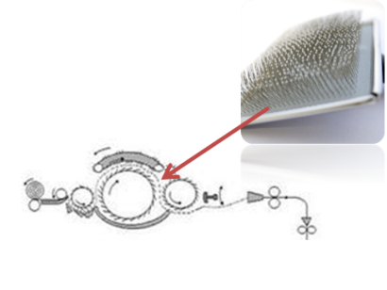
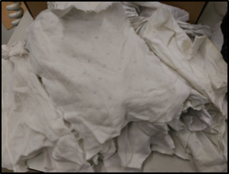
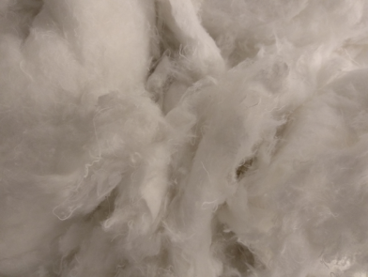
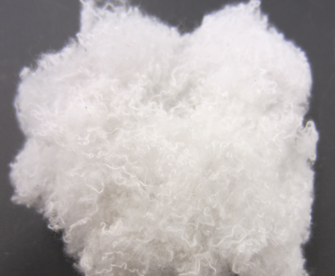
Textile Fibers
1
2
3
4
Washing
Cutting
1st Grinding
Textiles as received
Fibers obtained after 1st Grinding
Fibers obtained after 2nd Grinding
6.5 kg
Substrate in green wall (ALCN)

Slide 6
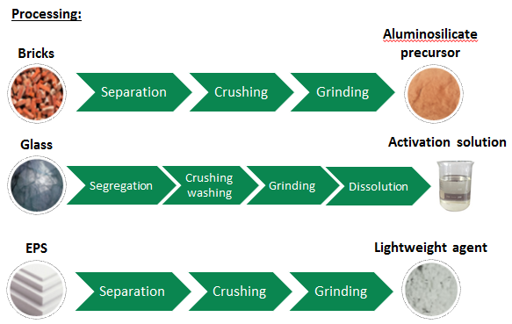
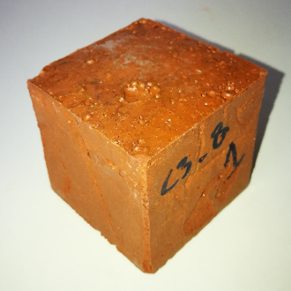
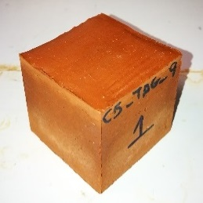
Geopolymer layer
Lightweight component
Comp. strength: 15 MPa
Flex. Strength: 3.2 MPa
Density: 1.3 g/cm³
CDW content: 92% w/w
Precast component
Comp. strength: 43 MPa
Flex. strength: 4 MPa
Density: 2 g/cm³
CDW content: 91% w/w

Slide 7
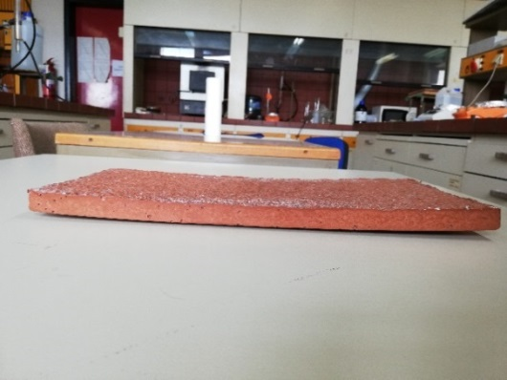
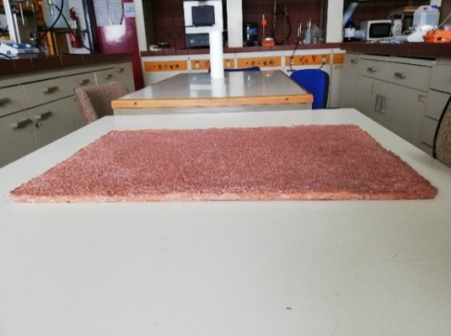
Issues due to the dimensions of the layers
drying shrinkage warping/cracking
increase fiber length add 6% CAC
from 6 to 12 mm cure under lid
Geopolymer layer showing warping/cracking
Final geopolymer layer
Properties
Specific Heat (kJ/kg∙°C) | 0.9 | Compressive Strength (MPa) | 15.3
Thermal Conductivity (W/m.K) | 0.45 | Water absorption (%) | 4.1
Density (kg/m³) | 1300 | Sorptivity (mm/min²) | 0.18
Poisson's Ratio | 0.11 | Wet – dry cycles | Stable
Young's modulus (GPa) | 1.3 | Flammability | inflammable
Tensile Resistance (MPa) | 3.2 | CDW content (wt. %) | 88
12.5 m²/240 Kg
COOLH

Slide 8
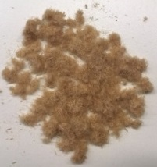
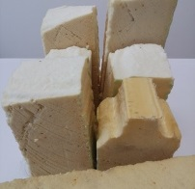
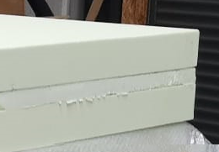
PU foam layer
too high density
1st approach: produce fresh PU from recycled PU
too low mechanical properties
2nd approach: use pristine PU – use CDWs as fillers
 | Soft | Rigid
CDW PU foam (%) | 1.5 | 0
CDW Wood fibers (%) | 0 | 2
Density (kg/m³) | 24 | 46
Compression Strength (MPa) | 0.015 | 0.113
Tensile strength (MPa) | 0.023 | 0.239
Young Modulus (MPa) | 0.518 | 2.919
Thermal Conductivity (W/m.K) | 0.0338 | 0.024
wood fibers
PU foam
95 m²/85 kg
COOL/AVR

Slide 9
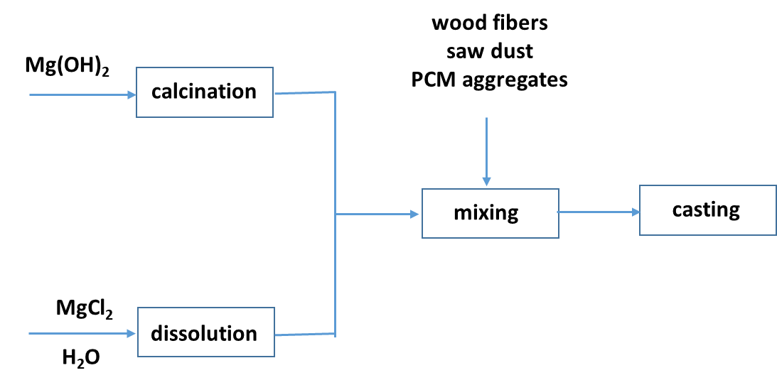
Magnesium Oxychloride Cement (MOC)
20% w/w CDW content
(aggregates, fibers, saw dust)
Properties
Compressive strength (MPa) | 41.9
Tensile strength (MPa) | 10.4
Young's modulus (GPa) | 2.7
Density (kg/m³) | 1050
Thermal conductivity (W.m⁻¹.°C⁻¹) | 0.31
130 kg
COOL/AVR

Slide 10
Aggregates with PCMs
50% w/w CDW content
(concrete aggregates)
Properties | Values
Bulk density (g/cm³) | 0.8
Water absorption (% wt.) | 0.05
Mass loss (% wt) | 1.8
Thermal conductivity (W/m.K) | 0.141
Heat storage capacity before thermal cycling (J/g) | 23.7
Heat storage capacity after thermal cycling | 21.2
19 kg
MOC layer

Slide 11
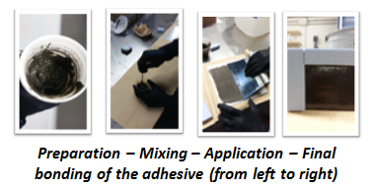
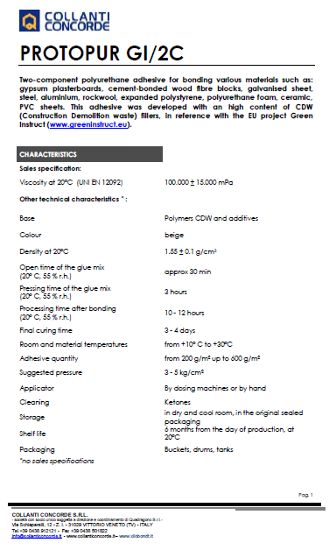
Structural adhesive
Properties | L2520/2C | GI/2C
Viscosity | 10000 cps | 100000 cps
Mixing ratio with CTZ GI17 | 4 to 1 | 4 to 1
Pot Life of the mixture | 40 min | 30 min
Minimum Pressing Time | 4 h | 3 h
Tensile Strength (single lap shear test) | 8.2 MPa | 23.3 MPa
Shore D | 50 | 85
Final Hardening Time (2mm thickness) | 24 h | 24 h
VOC | < 0.1 | < 0.1
CDW content (cement powder) : 62% w/w
7.5 kg
CID

Slide 12
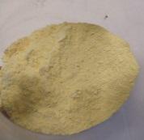
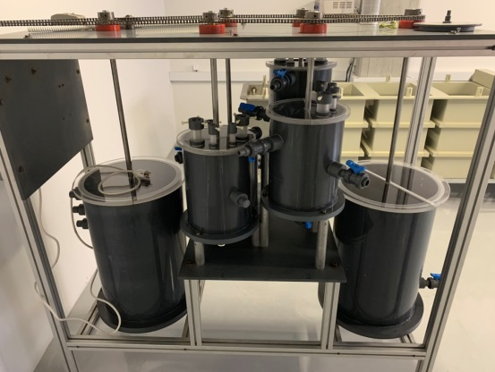
Photocatalytic Paint
TiO₂/SiO₂ nanopowder doped with thiourea
Synthesis of
photocatalytic powder
Synthesis of
paint
up scaling
Ingredients | water | Kronos 2360 | fillers | additives | Cnano powder
% w/w | 27.2 | 15 | 29 | 23.8 | 5
4 L
ACCIO/STRESS

Slide 13
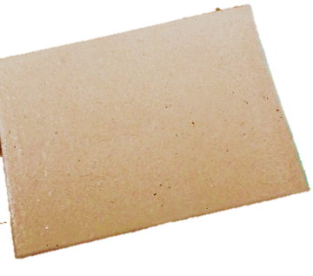
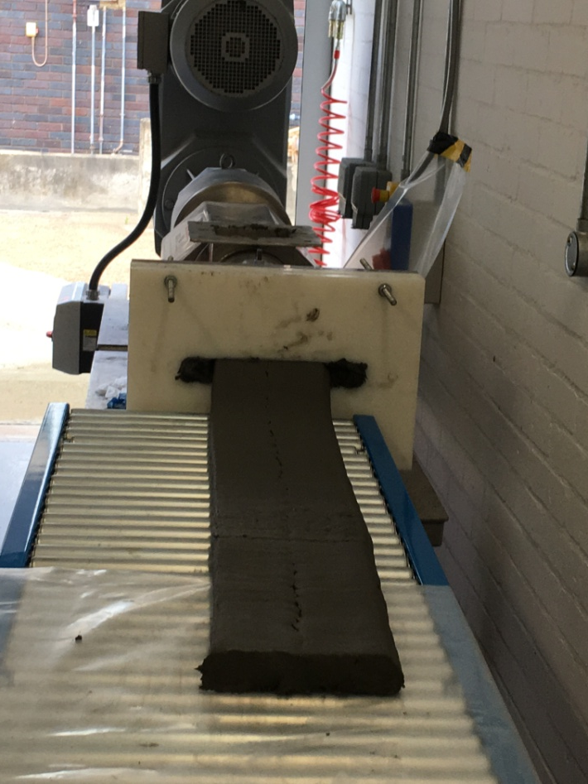
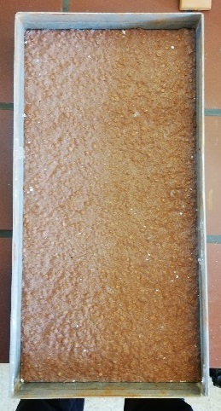
Extrusion/casting of geopolymer and MOC

Slide 14
Characterization of materials
Measurement database
http://www.greeninstruct.eu/technology-transfer/
Info Part
list of samples
techniques
Instrumentation
measurement conditions
Measurement Part
Raw measurement files
Available upon request
7 partners
27 techniques
454 samples
open access

Slide 15
CDW content in GI panel
INTERNAL + EXTERNAL PANEL
 | GREEN WALL WITH ALUMINIUM FRAME |  |  | GREEN WALL WITH SS FRAME
Material | Weight (kg/m²) | CDW content (%) | CDW (kg/m²) | Weight (kg/m²) | CDW content (%) | CDW (kg/m²)
Internal panel | 95.04 | 65 | 61.56 | 95.04 | 65 | 61.56
Green wall | 82.27 | 98 | 80.62 | 85.15 | 95 | 80.89
TOTAL | 177.31 |  | 142.18 | 180.19 |  | 142.45
CDW in panel (%) | 80 |  |  | 79

Slide 16
Conclusions
10 CDW streams were valorized as raw materials, constituents, reinforcing/functional agents in GI panel
plastics, textiles, wood, bricks, glass, EPS, PU, concrete, cement, Al/stainless steel scrap
fibers, geopolymers, insulation layer, MOC, PCMs aggregates, adhesive, frame, green wall cassette, plant substrate
11 products were developed and incorporated in the GI panel
The GI panel contains 80% w/w CDWs

Slide 17
Thank you for your attention
Dr Glikeria Kakali
kakali@central.ntua.gr

