Slide 1
The RE⁴ innovative sorting system based on automated robotics
Tommaso Zerbi, Stam Srl

Slide 2
AGENDA
Need
Objectives
Background and Expertise
System Specifications
Design Concept
System Architecture
Image Processing
Classification Principles
Tests & Results
Future Developments

Slide 3
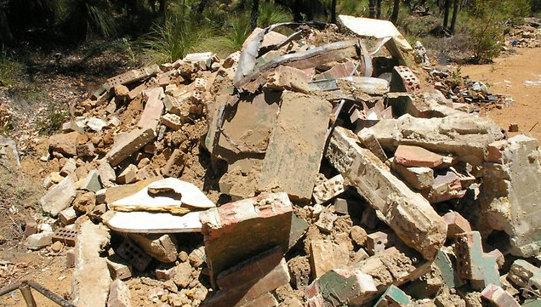
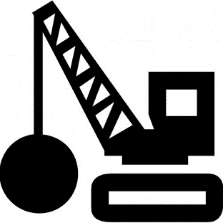
NEED
EU27: 750 Mt/year
European Commission identified Construction and demolition waste (CDW) as a priority target, formalized in the Waste Framework Directive, requiring Member States to achieve by 2020 a target of 70% by weight of non-hazardous CDW for reuse and recycling.

Slide 4
NEED
EU27: 750 Mt/year
State of the Art: EU27 average recovery rate 50%
Low-grade applications only (road base, fill, etc)

Slide 5
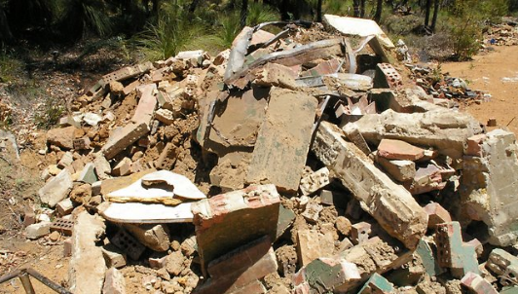
OBJECTIVES
Definition of a complete circular CDW management system

Slide 6
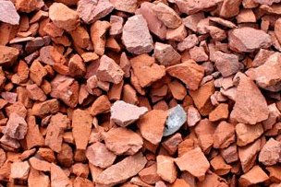
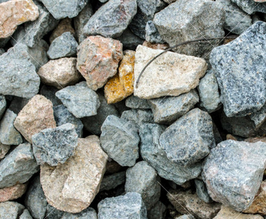
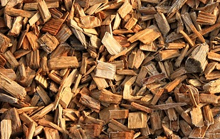
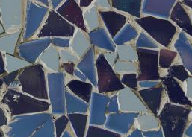
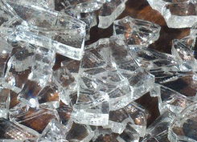
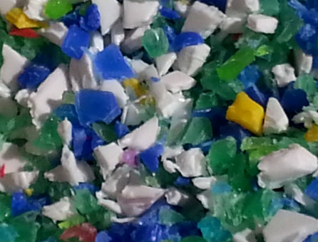
OBJECTIVES
Enhancing the technical and economic value of CDW-derived materials

Slide 7
OBJECTIVES
Structural concrete for load bearing prefabricated elements
SORTED AGGREGATES
Using such materials for energy efficient prefabricated building elements manufacturing
Geopolymer binder, cementitious materials
BRICKS & CERAMICS
Lightweight concrete, insulating prefabricated panels
PLASTICS
Insulating prefabricated panels
WOOD

Slide 8
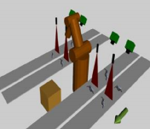
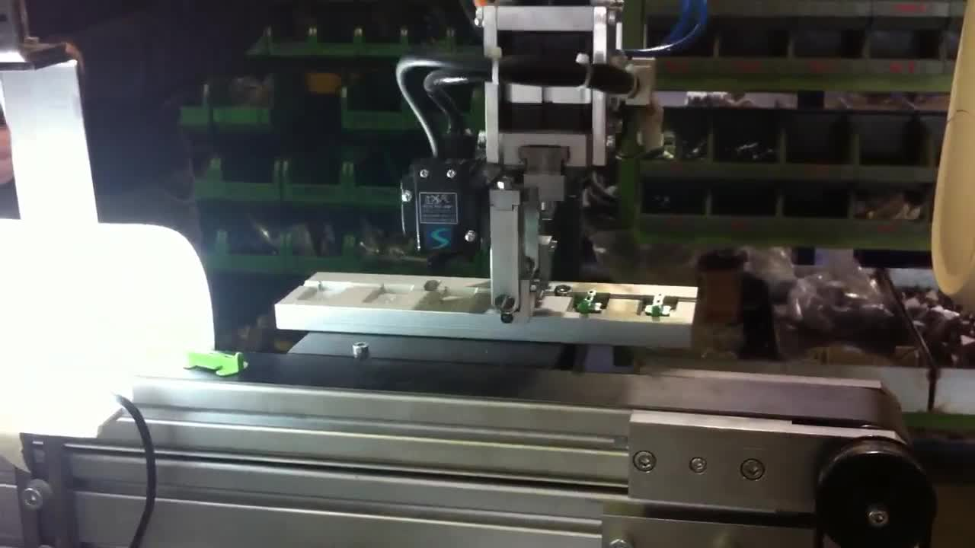
BACKGROUND AND EXPERTISE
Development of an Highly Flexible Indexing and Sorting System Based on Robotic Architecture Coupled with 3D
Vision Technology.
3D image acquisition and processing
Recognition and classification algorithms
Robotic system design
Mechanical and electronic integration

Slide 9
SYSTEM SPECIFICATIONS
Requirement | Value / Notes
Materials to be classified | Bricks, stone, ceramics, glass, plastics, wood
Working mode | Fully automatic
Pick rate | 100 pcs/min
Minimum payload | 3 kg
Maximum contamination | 5%
Productivity | 100 kg/h

Slide 10
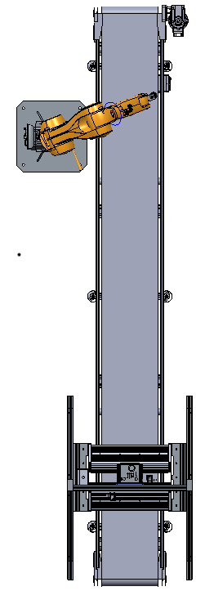
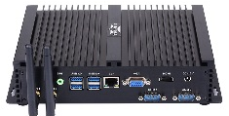
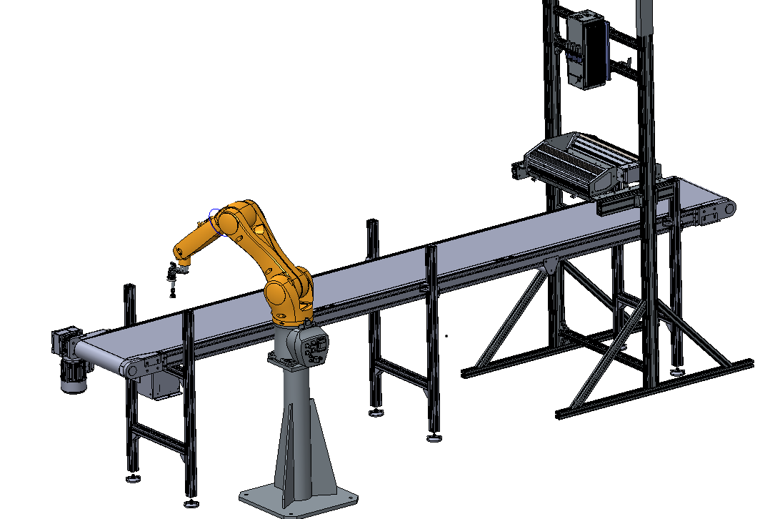
DESIGN CONCEPT
Processing unit
Image process
Real-time classification
Robot command
Actuation system
Perform pick and placement of the object to be classified
Hyperspectral camera
Line scans the belt
Sends signal to the main processing unit
Conveyor belt
400 X 4000 mm
0.13 m/s
White polyurethane
End-effector
Customized solution for pick and placement tasks
Illumination unit
Emits sufficient light in NIR range

Slide 11
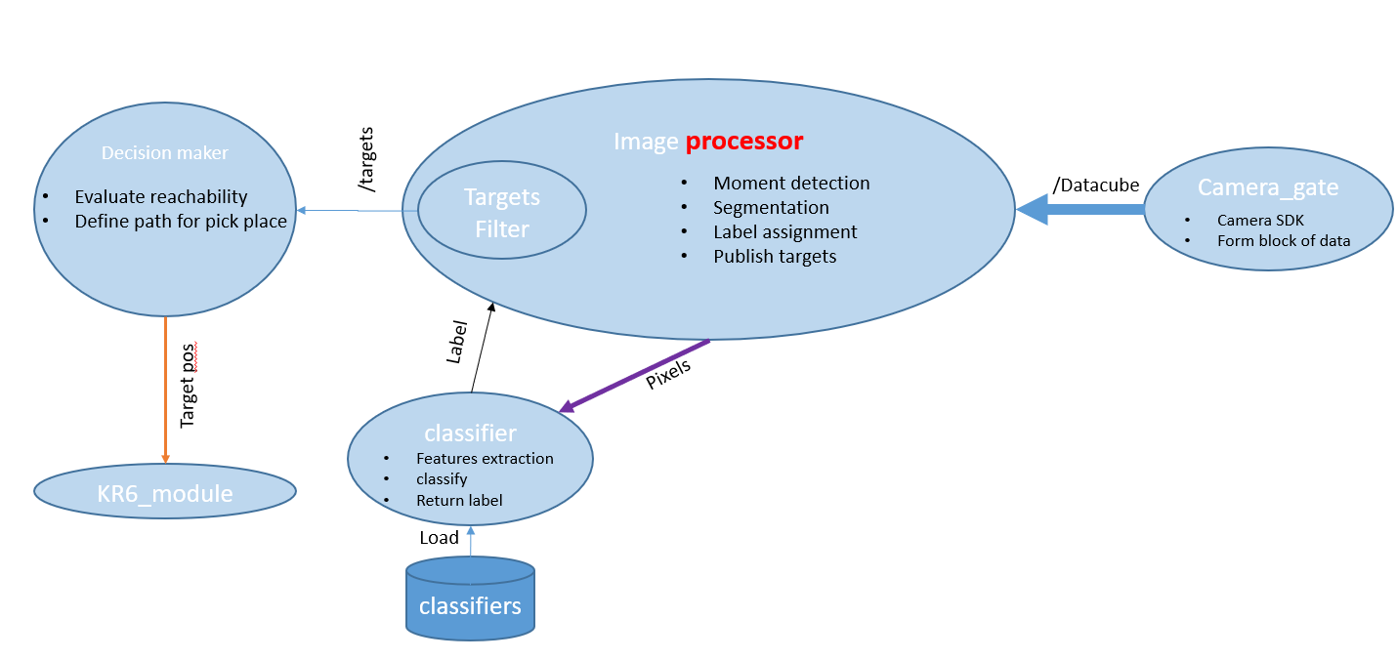
SYSTEM ARCHITECTURE
Notes:
DIFFERENT NODES
Image Processor: Label assigment in cooperation with the classifier
The Classifier load the MODEL (the Rules) before working in classification mode

Slide 12
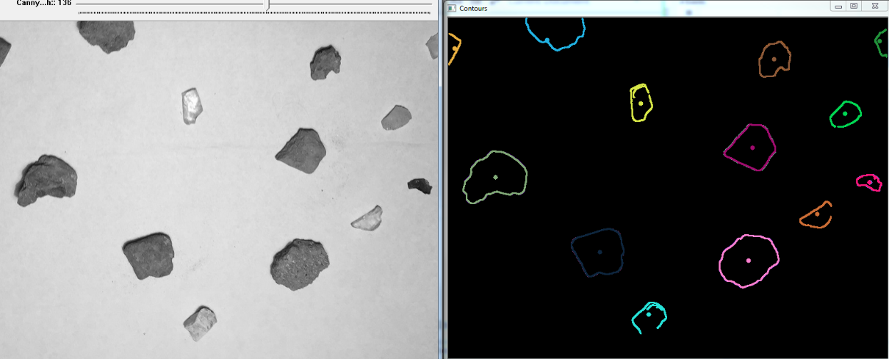
IMAGE PROCESSING
Select one layer of the hyperspectral cube for segmentation and object detection (denoising, foreground and edge detection, centroid identification)
Identification of a window of reliable pixels for every object inside a generated mask
Send these pixels to the classifier node
Track the objects for later pick and place tasks, it will be sent to the decision maker node with the results of the classifier
Notes:
Window of reliable pixels: a VOTE between 9 pixels select the label to be assigned

Slide 13
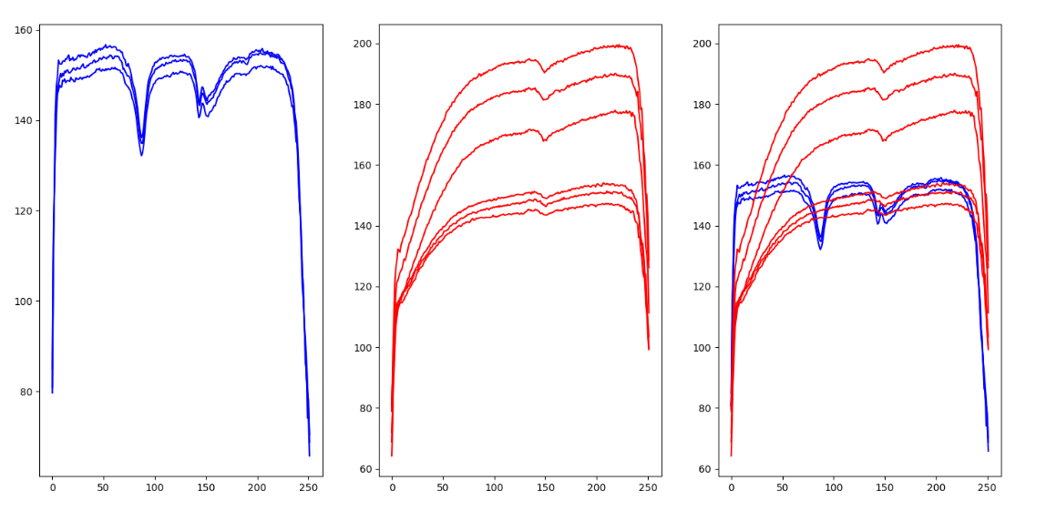
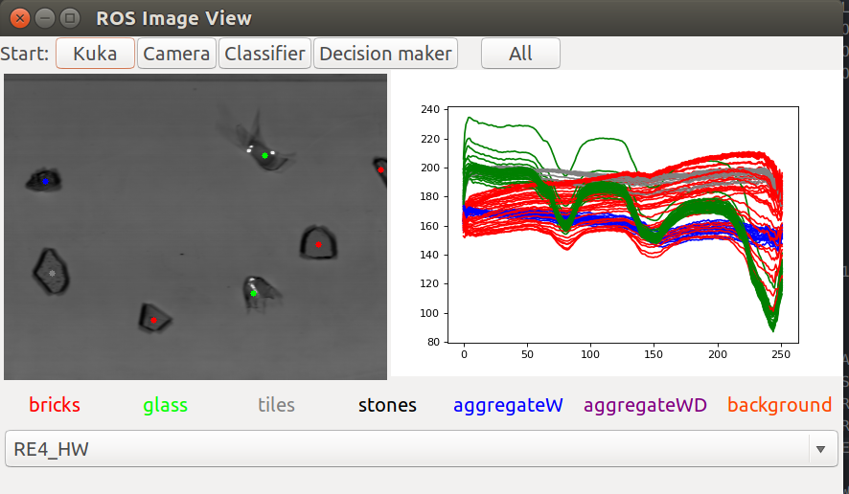
CLASSIFICATION PRINCIPLES
Different methodologies and algorithms have been tested
Dimensionality reduction with Linear Discriminant Analysis: find a linear combination of features that characterizes or separates two or more classes of objects or events
Normalization of number of sample with a combination of algorithms (Tomek Links algorithm, k-means, etc…)
Classification with a Linear Kernel SVM
Plastic
Wood
Comparison
Notes:
RAW DATA are the wavelengths signatures of the different pixels, giving 252 features (values). Mathematical methods are needed to discriminate between the different shapes (see pictures)
First of all, the dimensionality of the problem gets reducted by Linear Discriminant Analysis: DIMENSION REDUCTION: starting from 252 dimensions, down to around 15 dimensions
Keeping only the interesting samples, the testes methods are aimed at cutting the pixels very different from the other belonging to the same class, to uniform the classes
SVM: SUPPORT VECTOR MACHINE: finds a linear function in the multidimensional space of the problem, by iterating the MINIMUM SQUARE ERROR method

Slide 14
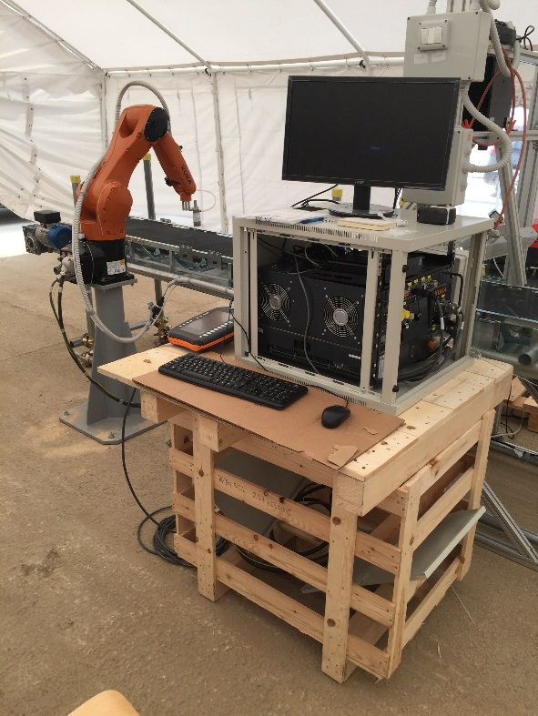
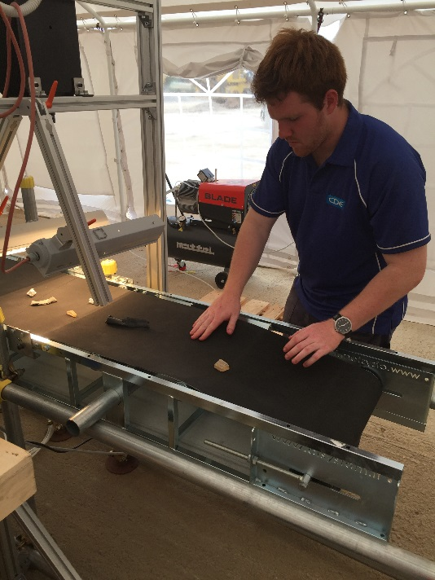
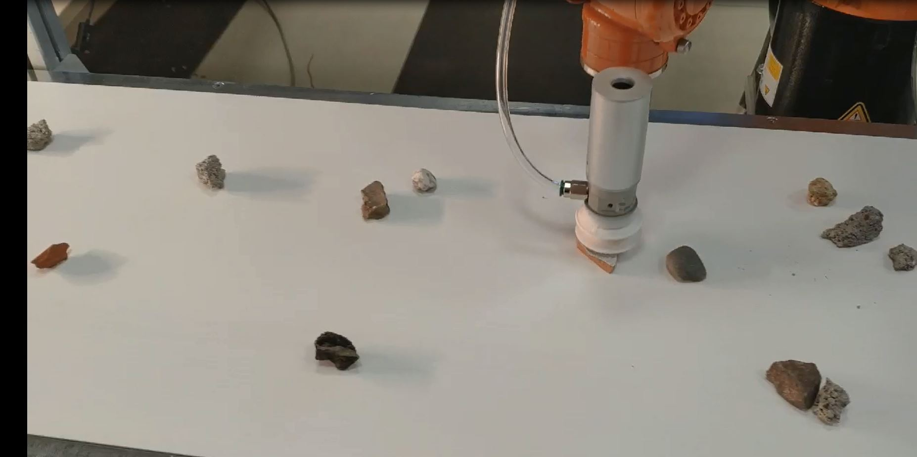
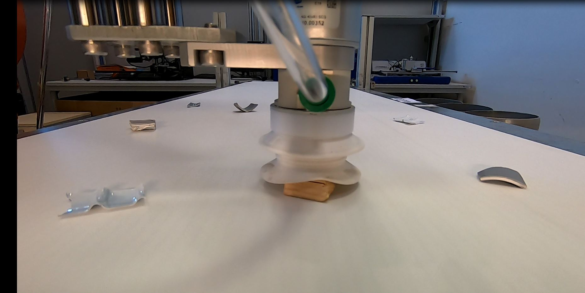
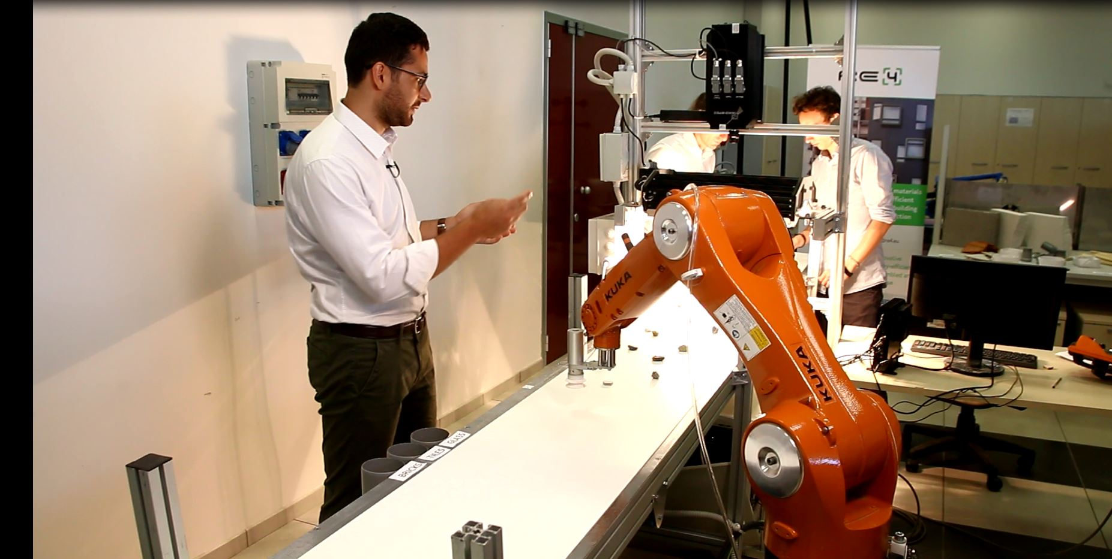
TESTS & RESULTS

Slide 15
TESTS & RESULTS
Parameter | Value
Materials sorted (1st classifier) | Bricks, stone+aggregates, ceramics, glass
Materials sorted (2nd classifier) | Plastics, Wood
Productivity | 780 pcs/hr
Classification Error | ~1%
Pick and Place Error | <1%

Slide 16
FUTURE DEVELOPMENTS
Testing the system with NN and CNN algorithms for object detection and classification
Industrial upscaling of the system:
Industrial look (integrating a PLC, safety measures, HMI, electric panel)
Increasing Performance (multiple pick and place, using more robots on the same line)
Notes:
NN – CNN (Convolutional): widely used in Image Processing and recognition problems, interesting to understand if with multidimensional datacubes have good results

Slide 17
Thank you for your attention
Tommaso Zerbi
t.zerbi@stamtech.com

