Slide 1
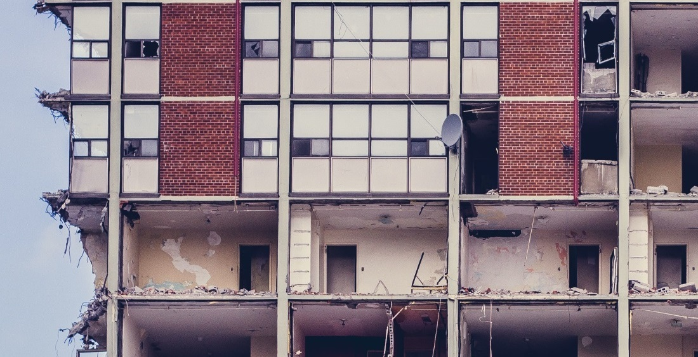
Title
Subtitle
Name / institution
Date / Location
Logo
This project has received funding from the European Union’s Horizon 2020 research and innovation program under grant agreement No. 723583

Slide 2
Presentation Structure

Slide 3
RE⁴ Project
Project Description and Objectives

Slide 4
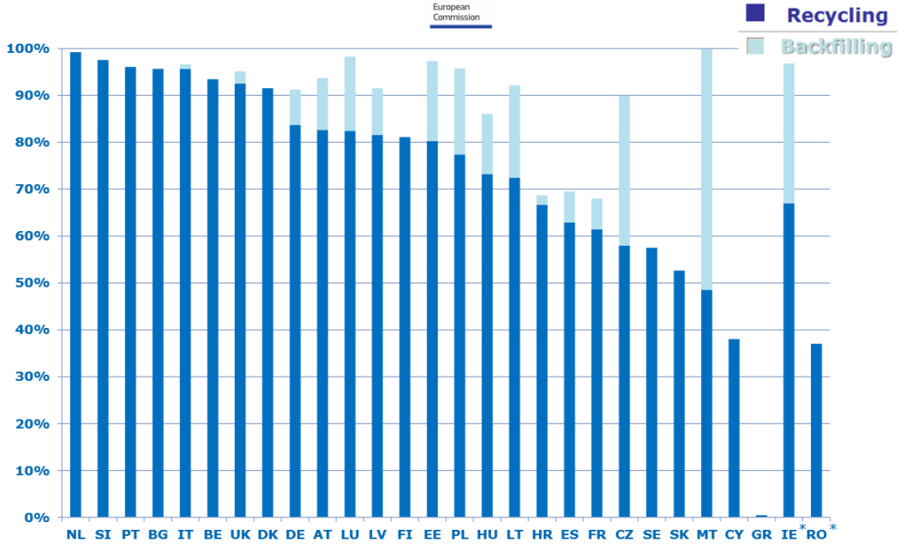
Background
868 million tonnes CDW generated in the EU in 2014 but insufficient material recovery
Existing buildings were not designed for dissassembly & reuse
Prefabrication industry: up to 50% less waste than conventional construction practices
CDW recycling & backfilling (2014)
Chart: European Comission
Data source: Eurostat

Slide 5
Motivation
Development of innovative technologies & reliable strategies
Increase % reuse & recycling from CDW
Increase CDW technical & economic value
Minimise future CDW from next generation of buildings
Increase building energy efficiency

Slide 6
Aim of the project
Develop a prefabricated energy-efficient building concept
Easily assembled/ disassembled for future reuse
Containing up to 65% by weight of recycled materials from CDW
Reusable structures will range from:
15-20% for exisiting buildings
80-90% for the RE⁴ prefabricated building concept

Slide 7
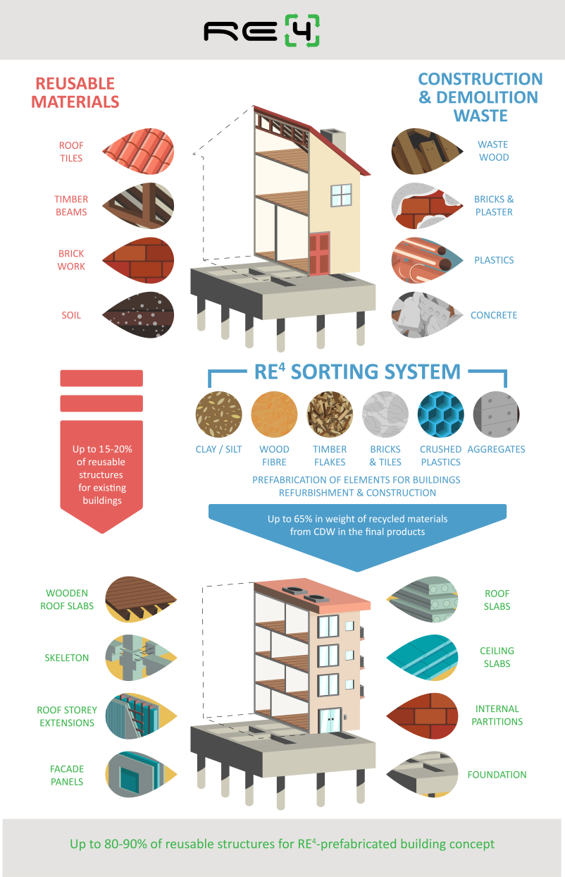
Objectives
Development of innovative design concepts for pre-fabricated building components
Innovative RE⁴ CDW sorting system based on an automated robotics system
Development of a BIM-compatible DSS and platform for CDW estimation and management
Development of business models for industrial exploitation
RE⁴ demonstration in an industrial environment

Slide 8
Objectives
Maximise recycled CDW amount & value by using advanced sorting technologies
Innovative RE⁴ CDW sorting system based on an automated robotics system
Assess properties of CDW-derived materials for building elements
Compliance check
Quality variability evaluation
Quality classes & optimal recycling strategy definition

Slide 9
Objectives
Development of prefab. elements integrating a high level of CDW-derived materials
Development of innovative design concepts for pre-fabricated building components
Design for modular/ smart installation & dissassembly/re-use

Slide 10
Objectives
RE⁴ demonstration in an industrial environment
For new constructions & refurbishment
Demonstration of strategy for disassembly & reuse
Enhance sustainability & future applications of RE⁴ prefab. products
>30% CO₂ savings & 20% energy savings
Resource efficiency: min. 65% recycled materials in final product
Less waste generation & disposal

Slide 11
Objectives
Development of a BIM-compatible DSS and platform for CDW estimation and management
Support owners & construction/demolition companies
Development of business models for industrial exploitation
Enhance replication potential
Economic assessment to evaluate profitability, undertand future cash flows, & highlight need for additional funding/investment
Notes:
DSS = Decision Support System
BIM = Building Information Modeling

Slide 12
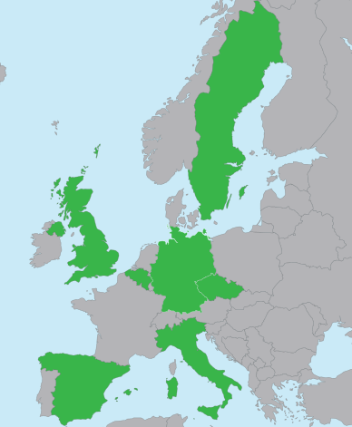
Project partners
Belgium
Sweden
UK
Germany
Coordinator
Italy
Czech Republic
Spain
Taiwan

Slide 13
Timeline
Sep 2016
2017
Feb 2020
May
2019
February
November
2018
April
August
April
Assessment of CDW streams across Europe
CDW sorting system based on robotic NIR sensors
Large-scale production of the selected products & elements
1
2
3
4
5
6
Project start
Project end
CDW separating system based on weight criteria
Design development of components for easy installation & disassembly
Demonstration buildings & performance analysis
Notes:
NIR = Near-InfraRed

Slide 14
Results

Slide 15
REuse and REcycling of CDW materials and structures in energy efficient pREfabricated elements for building REfurbishment and construction
Please visit our website www.re4.eu
Twitter: @RE4_project · Email: info@re4.eu
This project has received funding from the European Union’s Horizon 2020 research and innovation program under grant agreement No. 723583
The sole responsibility of this publication lies with the author. The European Union is not responsible for any use that may be made of the information contained therein.

