Slide 1
Bringing BIM into construction reality
Nina Turull Puig, EXERGY

Slide 2
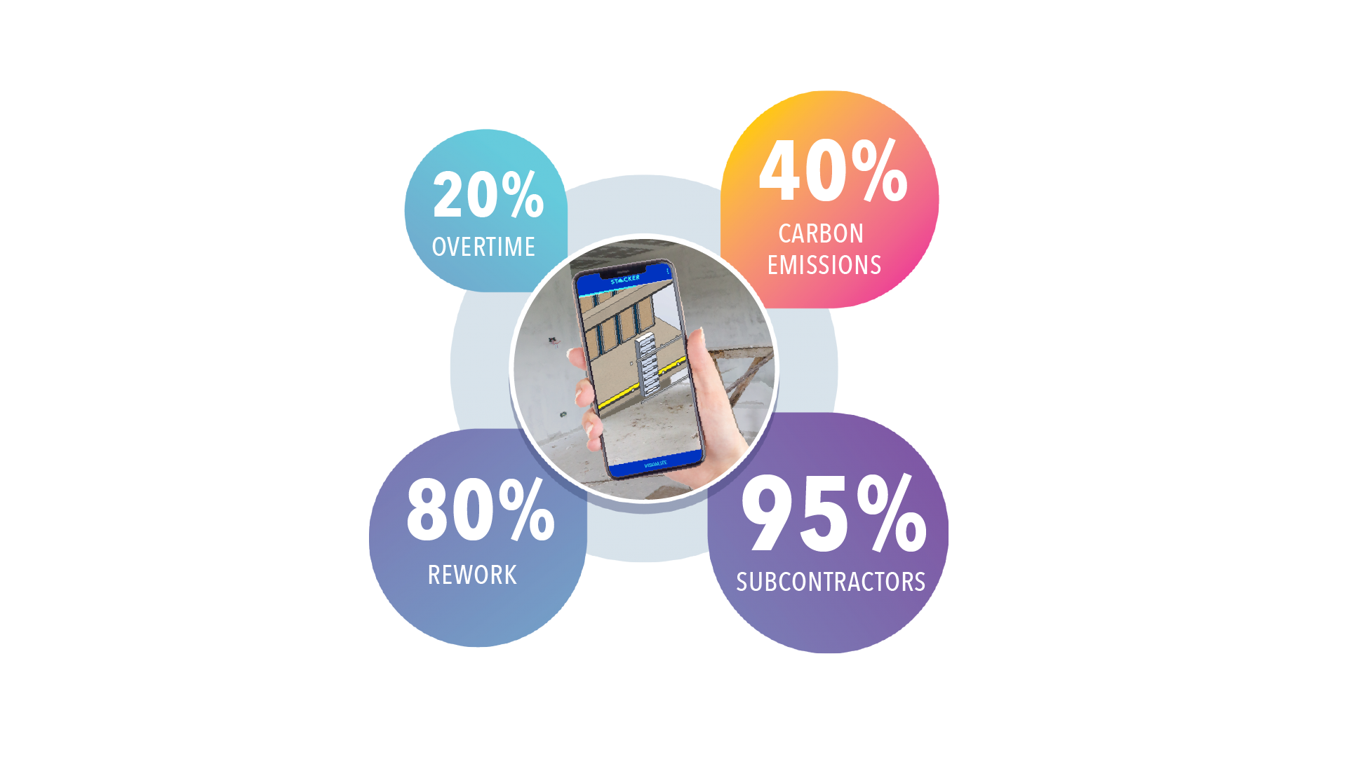
Construction challenges
Large construction projects typically require 20% more time to complete
Construction and built environment accounts for up to 40% of total manmade carbon emissions
Nearly 80% of construction work ends up with re-work and over budget due to unforeseen errors and mis-management of works
95% of construction labour force comprises of sub-contracted small to medium enterprises (SMEs)
52% of rework is caused by poor project data and communication

Slide 3
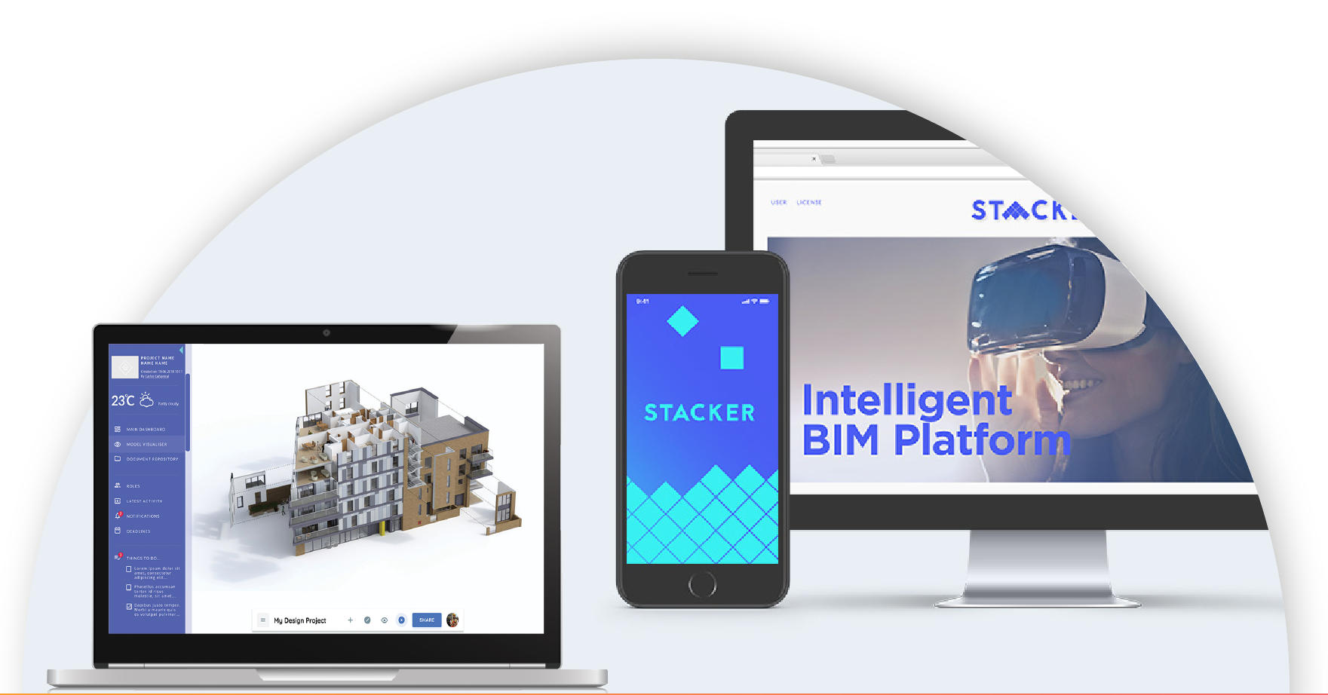
What is Stacker?
A mobile app that aims to improve the management and communication during installation of products for construction projects to ultimately reduce reworks, time and associated costs.
Significant waste reduction

Slide 4
Stacker’s value proposition
Get product specified at design stage
Packaged offer
Product Installation
Planning
Tracking and
quality control
Improve your product base on real data
Improved
Management & Communication
Better customer relationships
Manufacturer
Improve planning
Reduced risks of delays and associated costs
Tracking and sharing project information
Easy handover
Constructor
Planning time and arrival
Access documentation & instructions
Less mistakes
More efficiency
Feedback on work
Rating on workmanship
Subcontractor

Slide 5
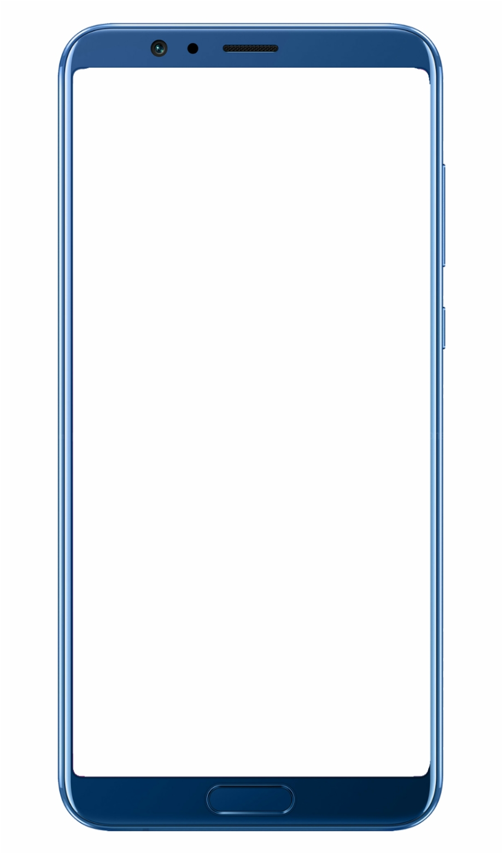
How does it work?

Slide 6
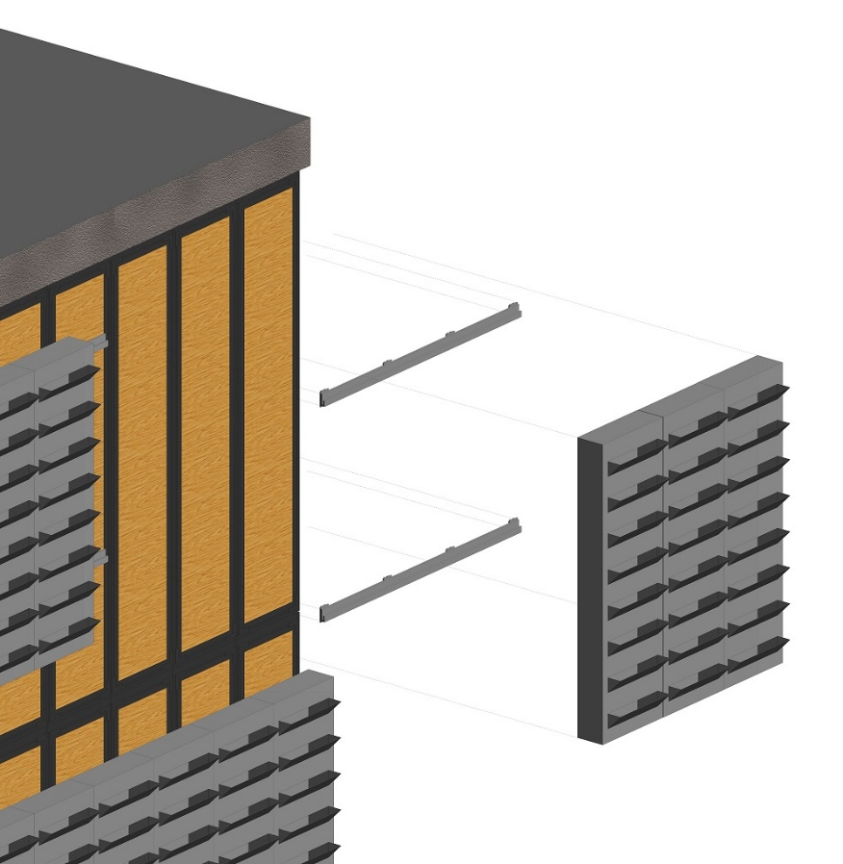
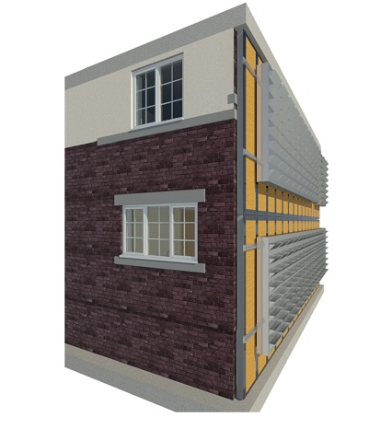
Prototype: The Green Instruct panel

Slide 7
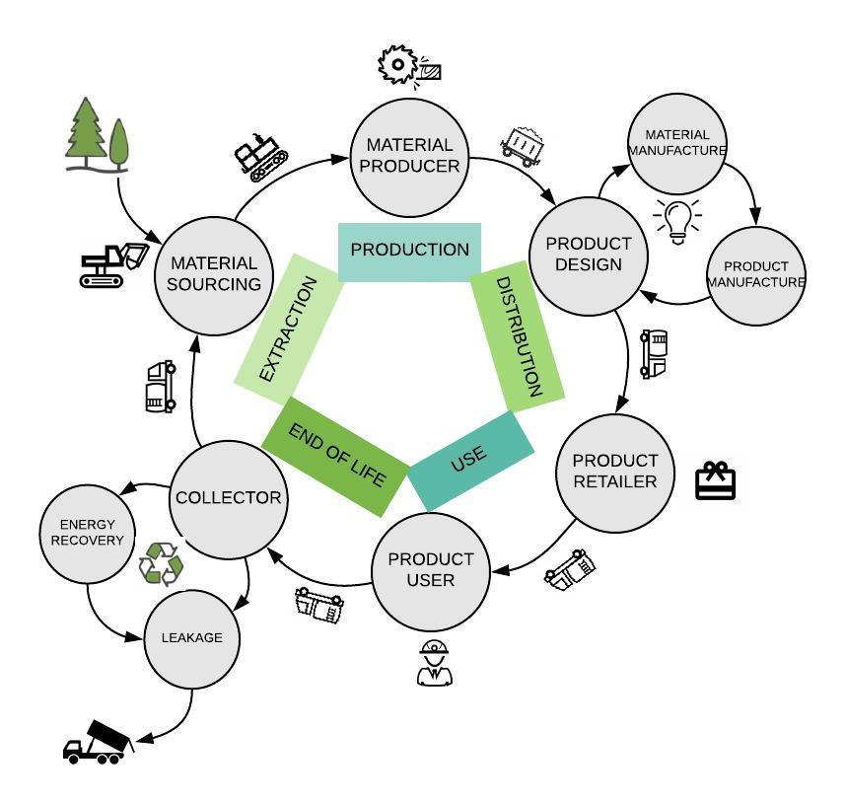
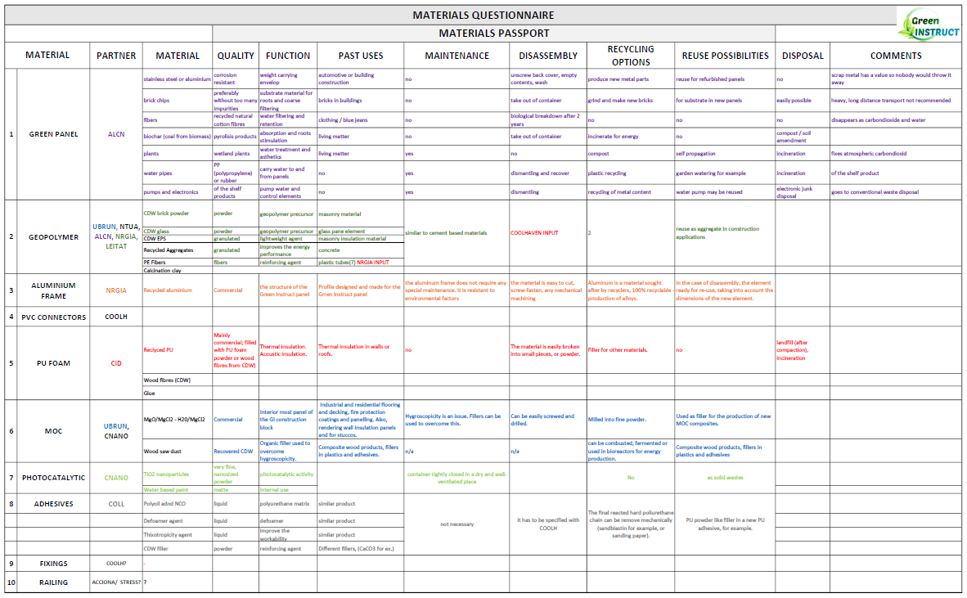
Design for disassembly and panel circularity

Slide 8
Thank you for your attention
Nina Turull Puig
nturull@exergy-global.com

