Slide 1
GREEN INtegrated STRUCTural Elements for Retrofitting and New Construction of Buildings
Xiangming Zhou, Brunel University London

Slide 2
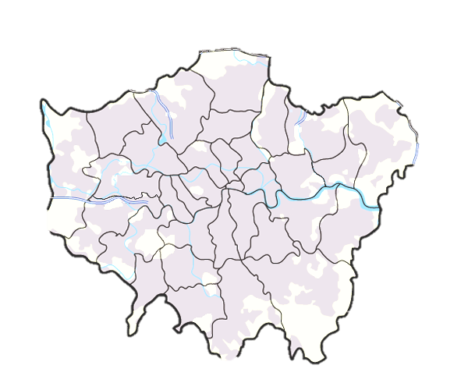
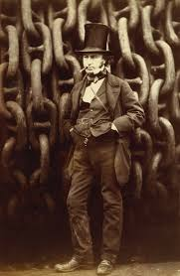
Where are we? Who are we?
Students: ~16,000
Staff: ~ 2,600
Colleges: 3
Named after the great Victorian engineer Isambard Kingdom Brunel

Slide 3
Project information
Call identifier: NMBP EeB-04-2016
Project number | 723825
Project value | 5.0 million €
Starting month | October 2016
Project Duration | 42 months
Our consortium

Slide 4
EeB-04-2016 Call Background
NMBP EeB-04-2016: New technologies & strategies for the development of pre-fabricated elements through the reuse & recycling of construction materials & structures
“In EU, CDW accounts 25-30% of all waste generated”
“demands large-scale re-use & recycling of CDW in construction industry”
“CO2 & energy reduction”
“pre-fabricated components to reduce costs & to facilitate installation/dismantling & re-use of components”
“recovery/ recycling of materials that have the highest technical and economic interest and which are associated to refurbishment or demolition processes”
“reuse different materials in energy-efficient buildings”
“the development of processes for easy disassembly”
“address strict regulations & standards (e.g. anti-seismic) in several European regions”
“optimization of recyclability properties through the uptake by the manufacturing chain”
Etc.

Slide 5
Main objectives
Efficient, robust, eco-friendly and replicable processes
Cost efficient products and new supply chains
Safe and energy efficient buildings
Comfortable, healthy and productive environment
Sustainability and cost savings through CDW sourced materials & C2C

Slide 6
Expected impacts
High CO₂ and energy inputs savings during the fabrication and operation processes
High rates of CDWs recycled and reused during building blocks fabrication
Re-entry into production lines with coherent design strategies
Incorporation of the safety-by-design approach
Reduction of uncertainty linked to the use of recycled products

Slide 7
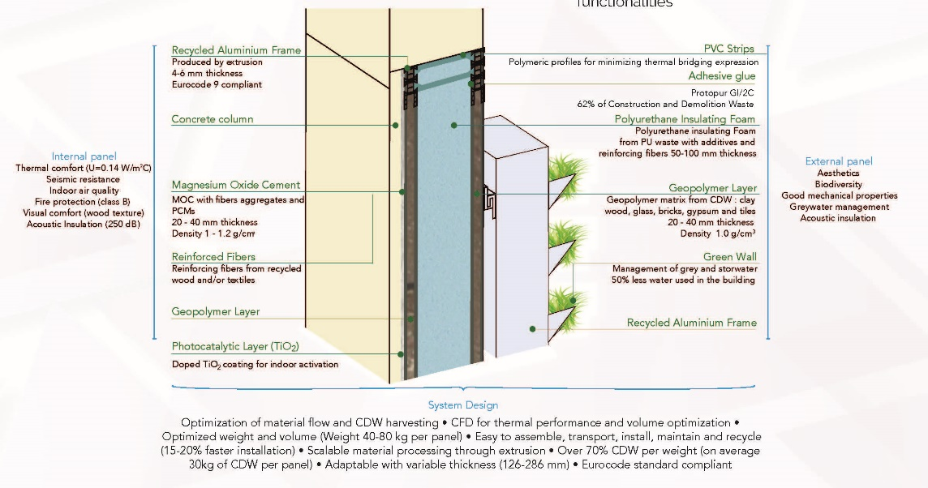
Green INSTRUCT at a glance

Slide 8
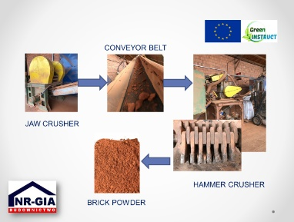
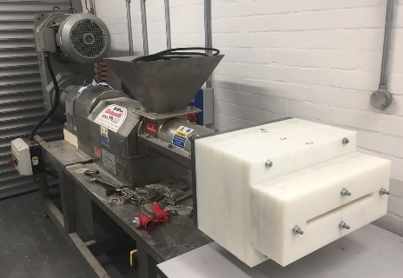
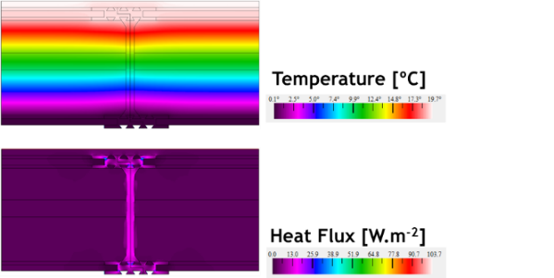
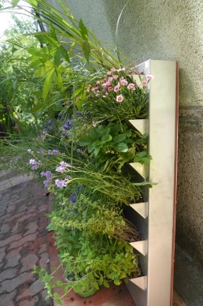
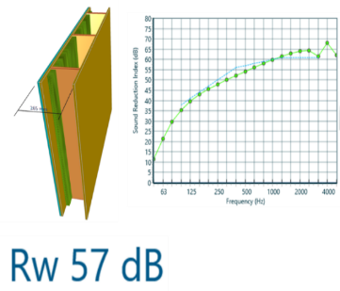
Main innovations
Prefab structural building block suitable both for retrofitting as well as new construction
>70% per weight of CDW
U-value of 0.14 W/m^{2º}C
Acoustic insulation in the 55-60dB
Vertical Green Wall
Continuous manufacturing using extrusion

Slide 9
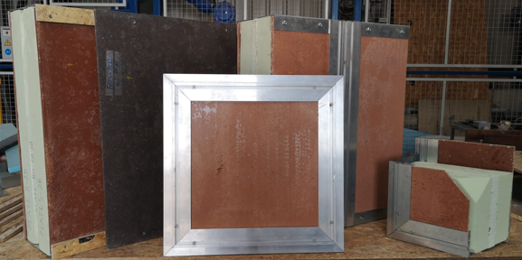
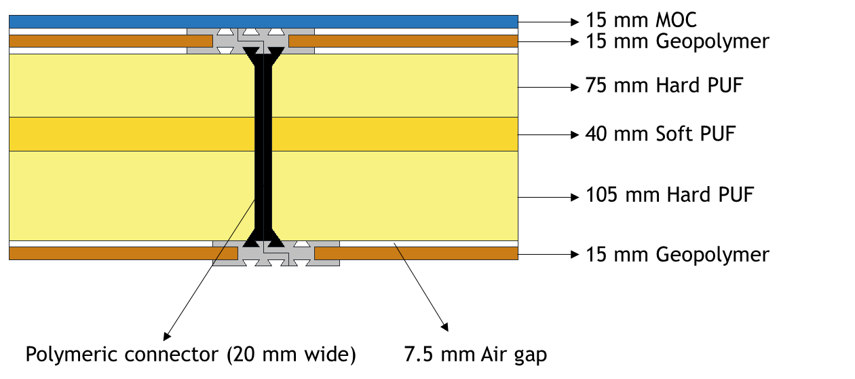
Highlight of the achievements
Innovative panel design,
Connection, assembly, replacement & dismantle

Slide 10
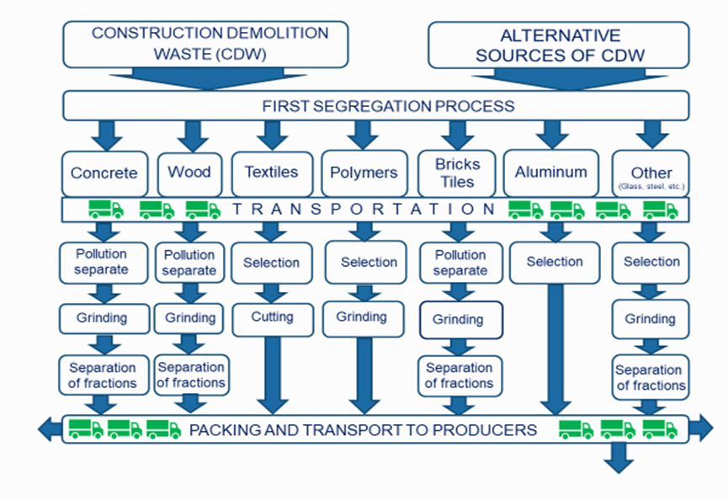
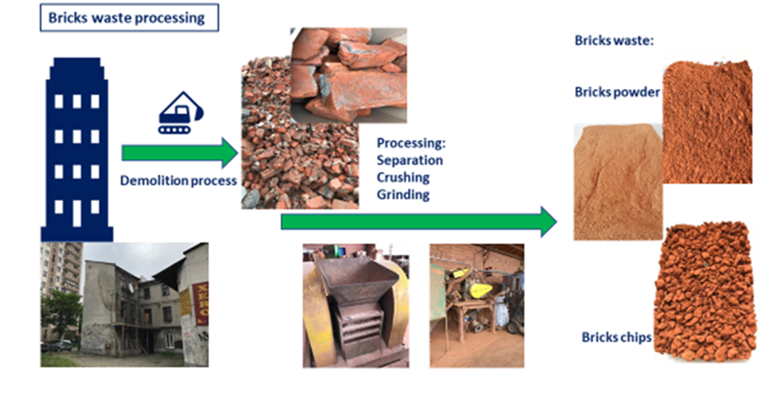
Highlight of the achievements
A clear collection, separation, sorting and characterisation strategy

Slide 11
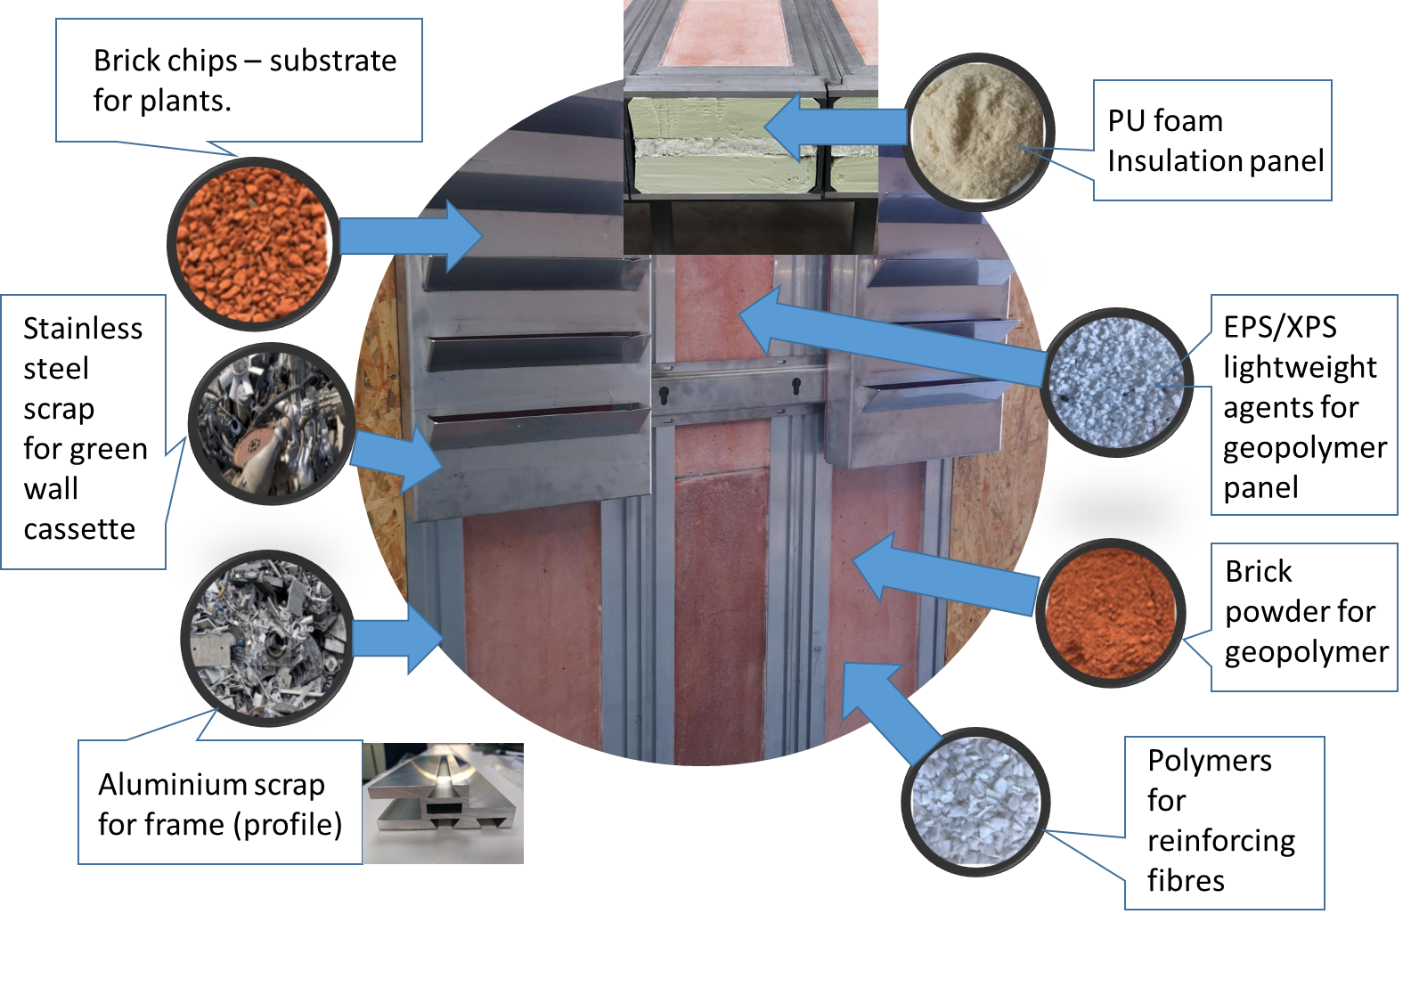
Highlight of the achievements

Slide 12
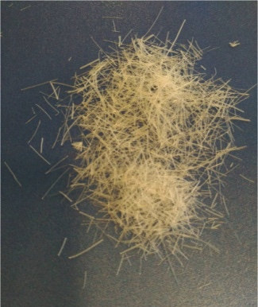
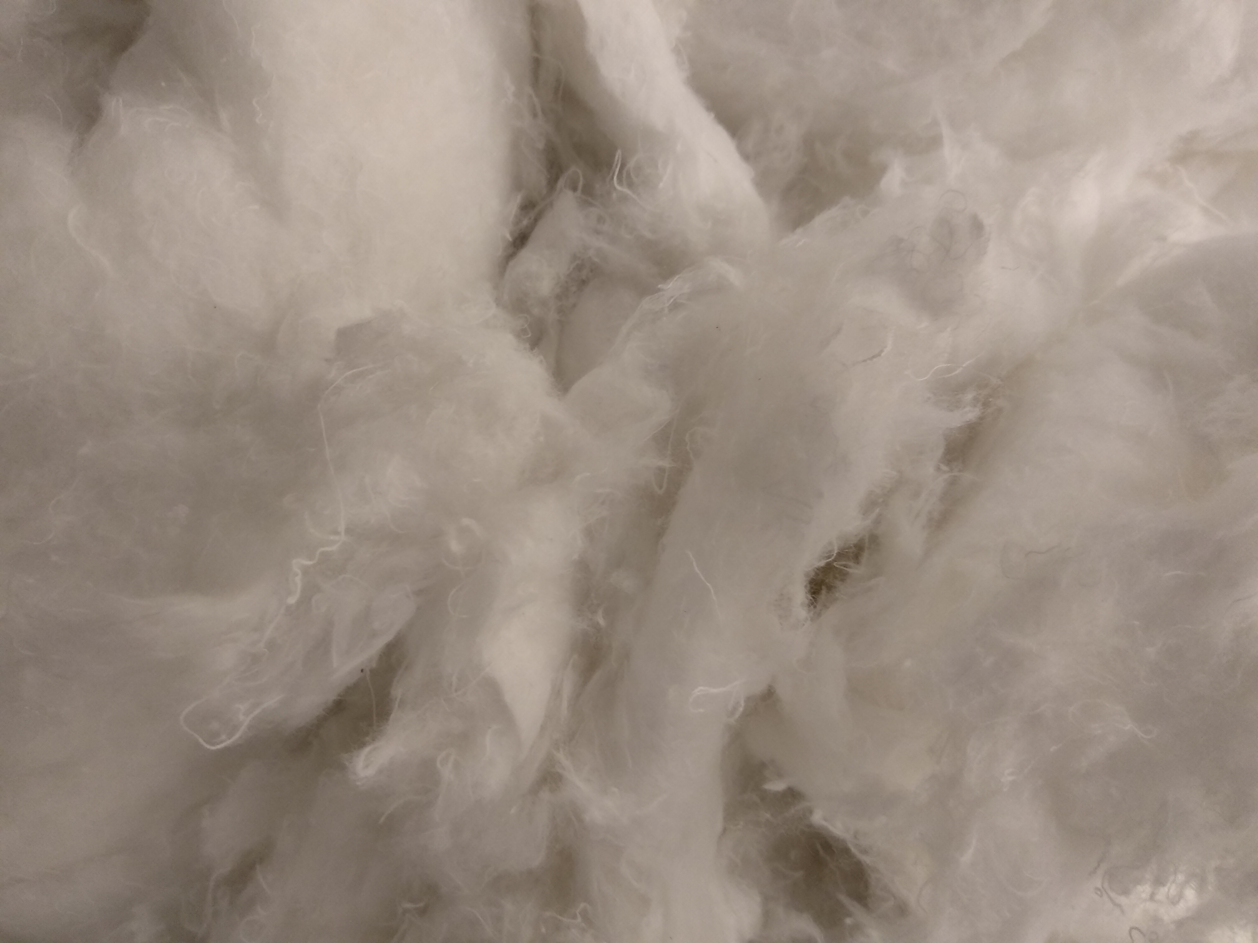
Highlight of the achievements
Extruded PU fibres
Recycled textile fibres
Recycled wood fibres
Manufactured fibres from CDW (plastic, textile, wood) for reinforcing geopolymer, MOC, PU, structural adhesive etc.

Slide 13
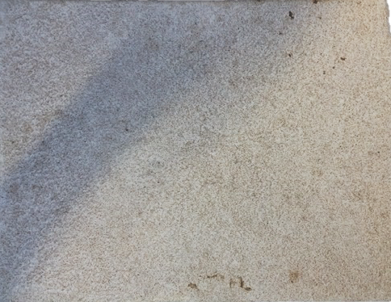
Highlight of the achievements
Magnesium Oxychloride (MOC) cement with sawdust and PCM aggregates

Slide 14
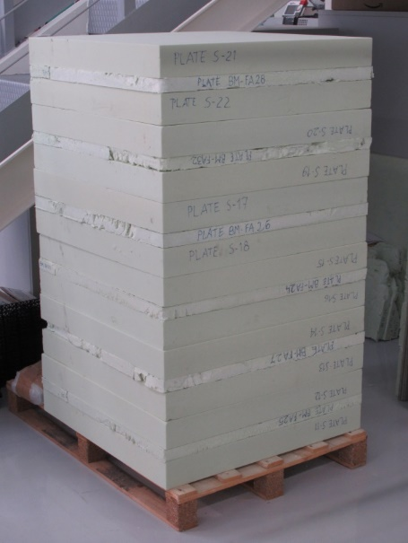
Highlight of the achievements
Soft PU Foam
PU foam (CDW) | Density (g/cm³) | Compression Strength | Tensile strength |  | Thermal conductivity
 |  | Em (MPa) at 10% | Young modulus (MPa) | Max. Resist. (MPa) |  | Lambda (w/m∙K)
1.5% | 0.0247 | 0.0148 | 0.518 | 0.023 | 0.03383
Hard PU Foam
Wood fibres | Density (g/cm³) | Compression Strength | Tensile strength |  | Thermal conductivity
 |  | Em (MPa) at 10% | Young modulus (MPa) | Max. Resist. (MPa) | Lambda (w/m∙K)
2% | 0.0241 | 0.0157 |  |  | 0.03395
Rigid and soft PU Foam with inclusion of waste PU foam and waste wood fibres

Slide 15
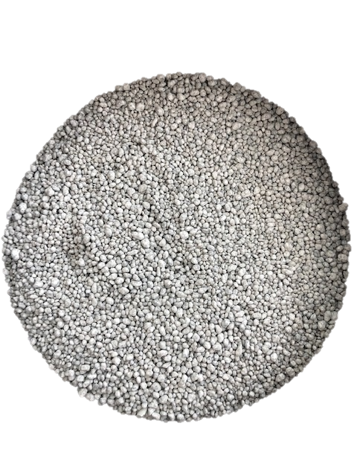
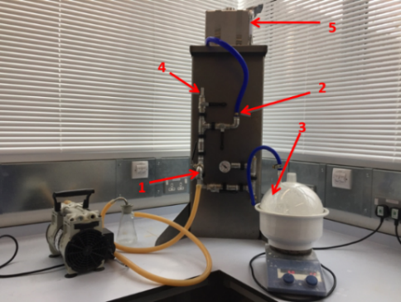
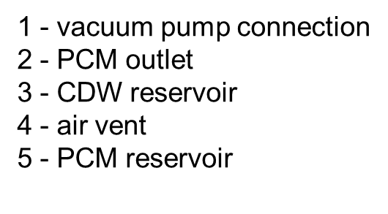
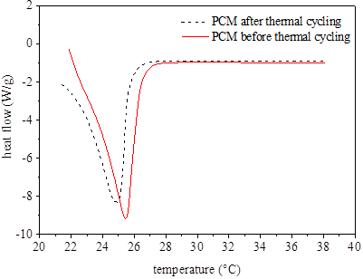
Highlight of the achievements
Bulk density (g/cm3) | 0.8
Water absorption (% wt.) | 0.05
Mass loss (% wt) | 1.8
Thermal conductivity (W/mK) | 0.141
Heat storage capacity before thermal cycling (J/g) | 23.7
Heat storage capacity after thermal cycling | 21.2
PCM-impregnated aggregates

Slide 16
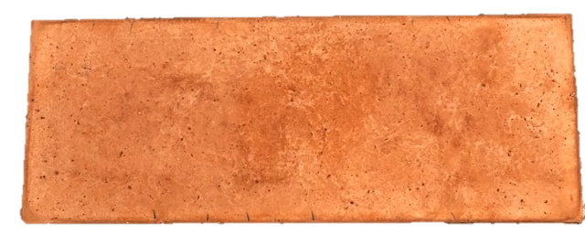
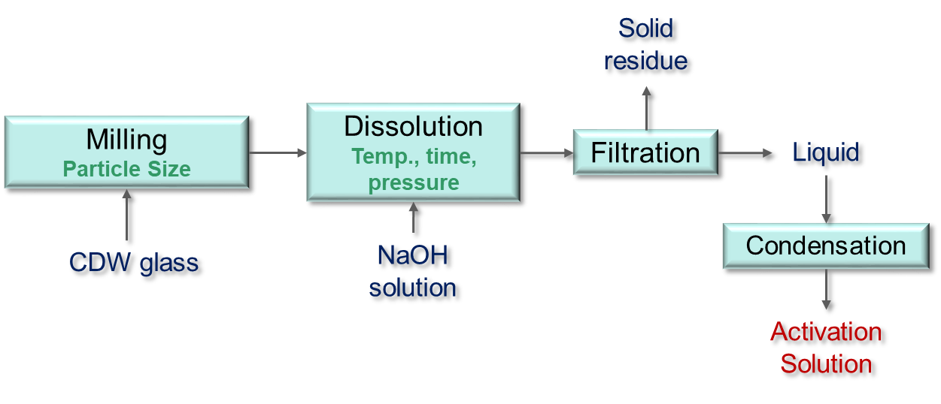
Highlight of the achievements
lightweight geopolymer from CDW (88 wt%)
Properties | EPS+PE
Specific Heat (KJ.Kg⁻¹.°C⁻¹ ) | 0.9
Thermal Conductivity (W.m⁻¹.°C⁻¹) | 0.45
Density (Kg.m⁻³) | 1400
Emissivity | 0.9
Poisson's Ratio | 0.11
Young's modulus (GPa) | 1.3
Tensile Resistance (MPa) | 3.2
Compressive Resistance (MPa) | 15.3
Hydrothermal process to convert waste glass into activation solution with 81% conversion rate

Slide 17
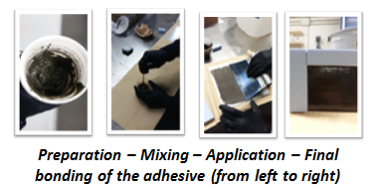
Highlight of the achievements
CDW content (cement powder) : 62% w/w

Slide 18
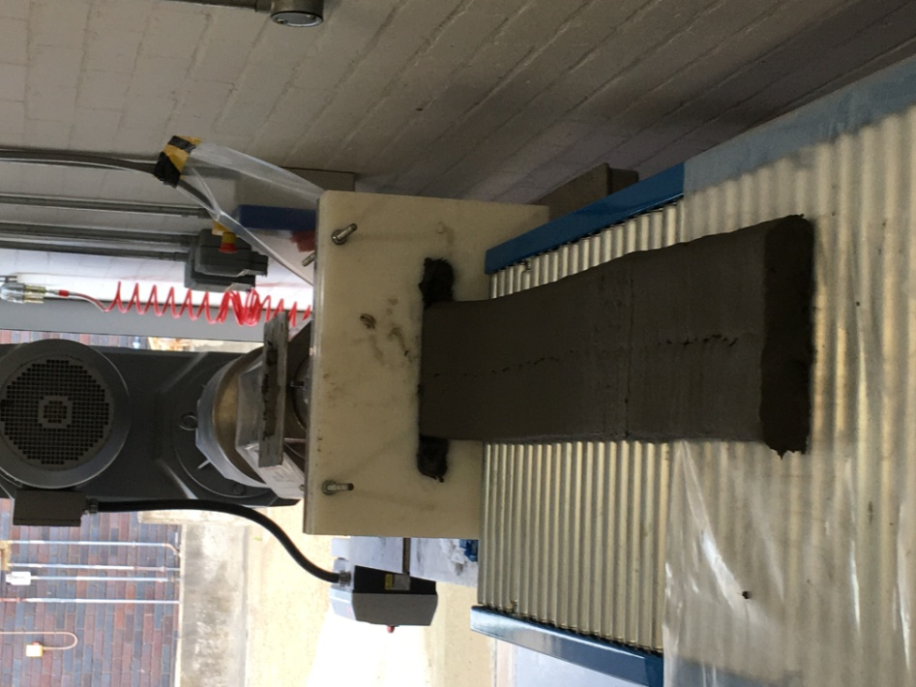
Highlight of the achievements
Successful extrusion and casting of Geopolymer panels and aluminium profiles

Slide 19
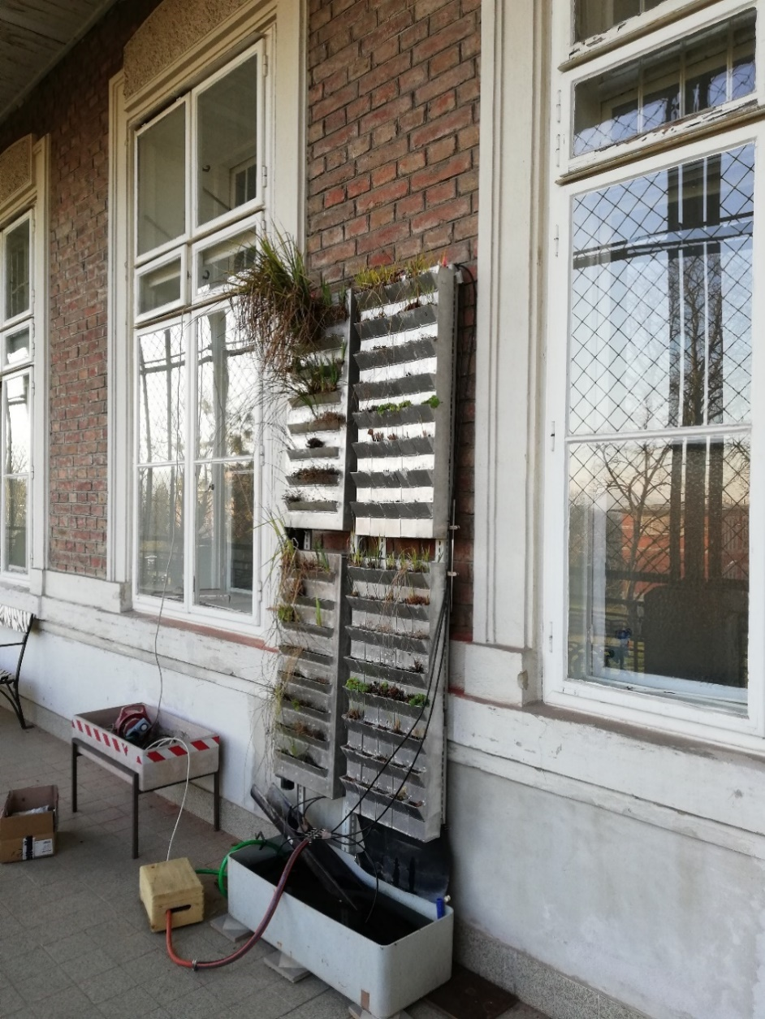
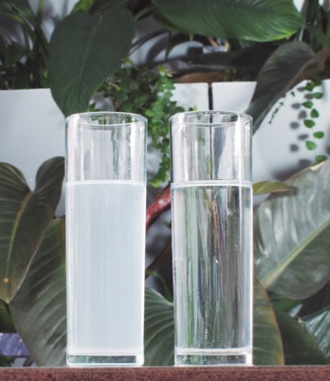
Highlight of the achievements
25 m² of green façade area needed to clean 1 m³ of greywater/day
Innovative green wall design with substrate & cassette from CDW

Slide 20
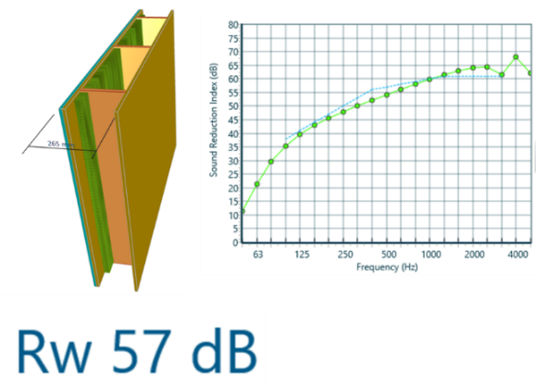
Highlight of the achievements
Optimised CFD modelling has achieved a U-value = 0.13 W/m²K and sound insulation performance of 57 dB

Slide 21
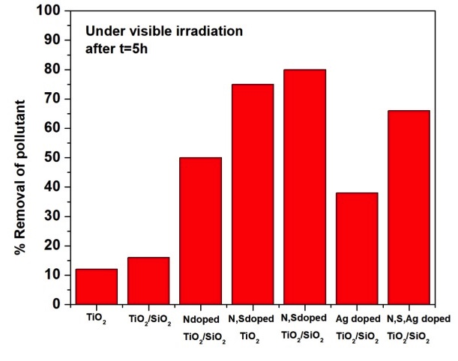
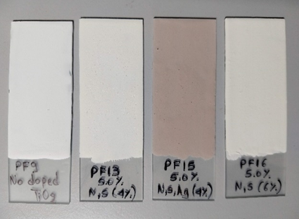
Highlight of the achievements
Developed a photocatalytic paint used for coating the MOC layer using doped TiO₂ nanoparticles with optimized loading and low agglomeration. The coating is harmless to human health and effectively improve indoor air quality.

Slide 22
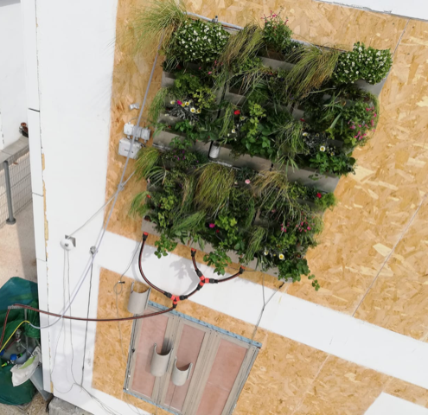
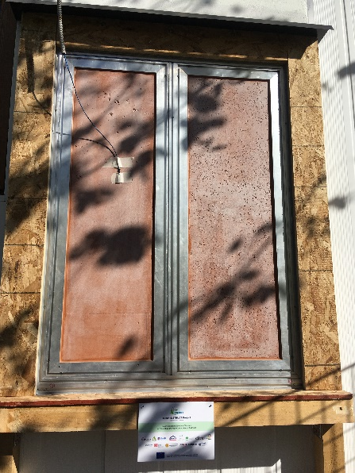
Highlight of the achievements
Demosntration

Slide 23
Thank you for your attention
Presenter name: Xiangming Zhou
Presenter email:
Xiangming.Zhou@brunel.ac.uk

