Slide 1
From demolition waste to top performance panel
Presenter João Simões, MSc civil engineer (Cool-Haven)

Slide 2
CONTENTS
THE PROJECT
EARLY DEVELOPMENT
CHALLENGES
FINAL DESIGN AND ASSEMBLY
FINAL PANEL DESIGN
ASSEMBLING PROCEDURE
PROTOTYPING
INSTALLATION OF PANELS
STRUCTURAL INTEGRATION AND IMPLEMENTATION
PREPARATION
SHOWCASING
KEY ASPECTS

Slide 3
THE PROJECT
Early development
Structural integration and implementation
FINAL DESIGN AND ASSEMBLY
Final panel design
Assembling procedure
PROTOTYPING
Challenges
INTRODUCTION
THE PROJECT
Early development
Structural integration and implementation
FINAL DESIGN AND ASSEMBLY
Final panel design
Assembling procedure
PROTOTYPING
Challenges
INTRODUCTION

Slide 4
THE PROJECT
Early development
Structural integration and implementation
FINAL DESIGN AND ASSEMBLY
Final panel design
Assembling procedure
PROTOTYPING
Challenges
INTRODUCTION
Introduction
CoolHaven, estabilished in 2009, is a company based in Coimbra, Portugal and started as a spin-off from the University of Coimbra.
We are specialized in the construction of Modular Light Steel Frame buildings and since the foundation, we have been providing the market with better construction quality, competitiveness and at the same time, at the cost of a much lower footprint.
COOLHAVEN
Much Cleaner worksite (dry construction)
Recyclable materials (wood & steel)
Greater quality control (Pre-fab)
Much faster building (Modular construction)
Very low water consumption (only foundation)

Slide 5
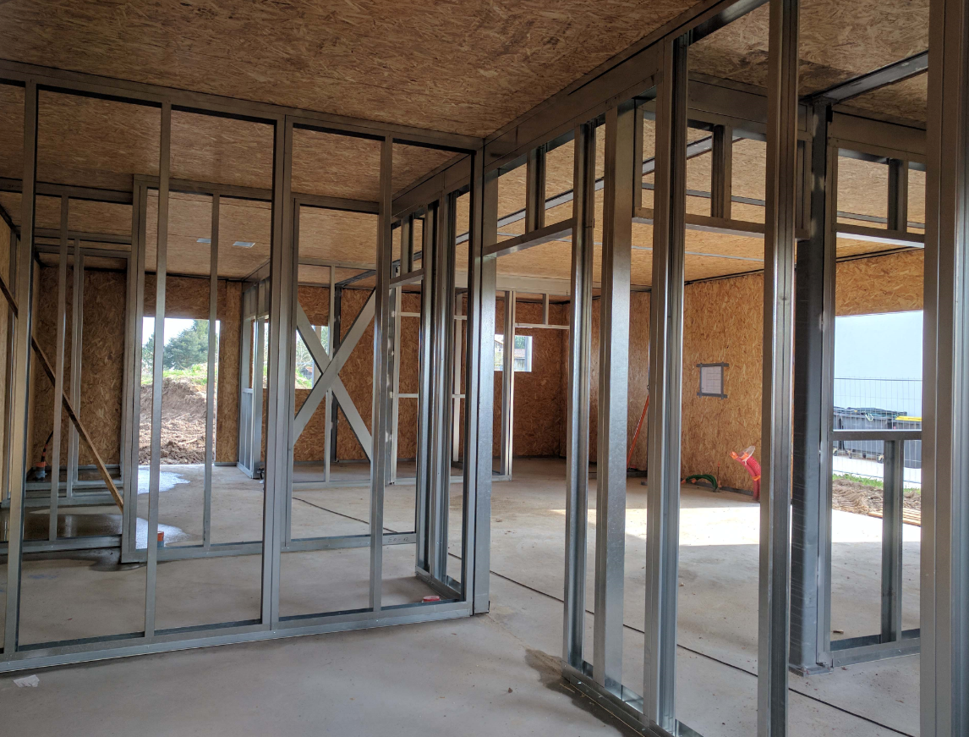
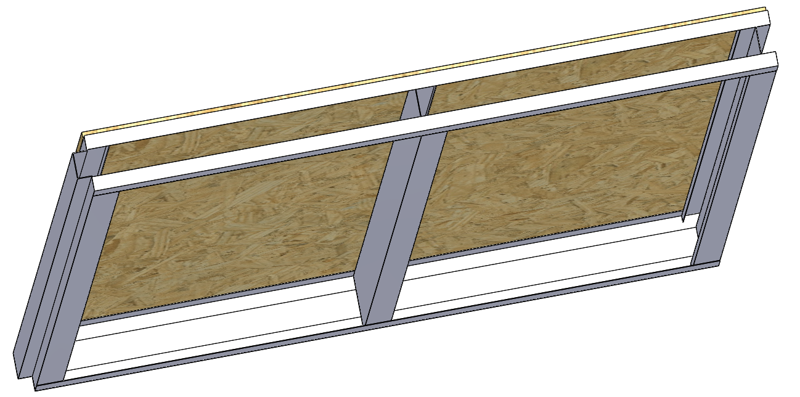
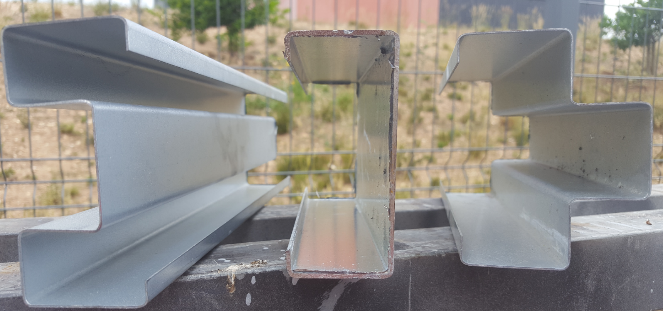
THE PROJECT
Early development
Structural integration and implementation
FINAL DESIGN AND ASSEMBLY
Final panel design
Assembling procedure
PROTOTYPING
Challenges
INTRODUCTION
1200 mm
100 mm
THE PROFILES
THE WALL MODULE
THE SYSTEM

Slide 6
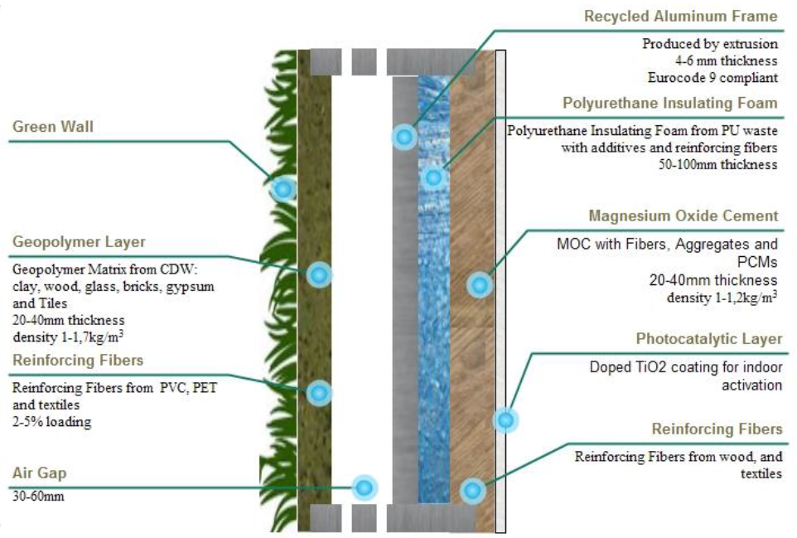
THE PROJECT
Early development
Structural integration and implementation
FINAL DESIGN AND ASSEMBLY
Final panel design
Assembling procedure
PROTOTYPING
Challenges
INTRODUCTION
The Project
Initial premises for the system:
Optimization of material flow and CDW harvesting;
CFD for thermal performance and volume optimization;
Optimized weight and volume (Weight (40-80kg);
Easy to assemble, transport, install, maintain and recycle (15-20% faster installation);
Scalable material processing through extrusion;
Over 70% CDW per weight;
Adaptable with tuneable thickness (126-286 mm);
Eurocode compliant;
Thermal comfort (U=0,14W/m².°C;
Seismic resistance;
Indoor air quality;
Class B fire resistance;
Visual comfort of the internal layer;
Acoustic insulation (55-60 db);
Aesthetics;
Biodiversity;
Physical resistance;
Greywater management;
Goal: Develop a high performance panelized construction solution out of construction and demolition waste

Slide 7
THE PROJECT
Early development
Structural integration and implementation
FINAL DESIGN AND ASSEMBLY
Final panel design
Assembling procedure
PROTOTYPING
Challenges
INTRODUCTION
Early development
Panel thickness calculus based on heat conduction (ISO 6946)
U = $0.14≥\frac{1}{0.04 + \frac{t_{PUfoam}}{0.025} + 0.13} ⇔ t_{PUfoam}≥17,4 cm$
External surface resistance
PUfoam’s thermal conductivity
Internal surface resistance
1st premise → Modular wall panel with 18 cm overall insulation.
Next Step : How to enclosure the insulation in a way that can provide continuity of the system?
Answer : adapt CoolHaven’s methodology replacing materials from regular Light Steel framing with materials under development from partners within the project adopting extrusion processes
Steel -> ALUMINIUM (Much lighter)
Oriented strand board (OSB) -> GEOPOLYMER (twice the density)
-> Magnesium oxide cement

Slide 8
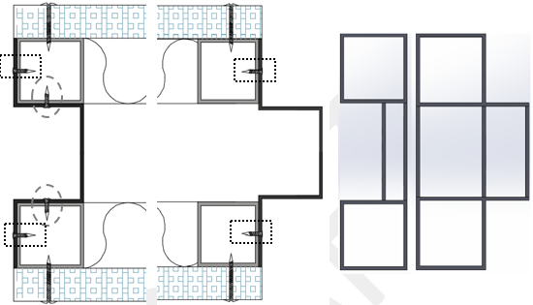
THE PROJECT
Early development
Structural integration and implementation
FINAL DESIGN AND ASSEMBLY
Final panel design
Assembling procedure
PROTOTYPING
Challenges
INTRODUCTION
Structural integration and implementation
1200mm
100mm
180mm
600mm
Insertion of 4 aluminium tubes in each panel corner for sturdyness
Extrusion process

Slide 9
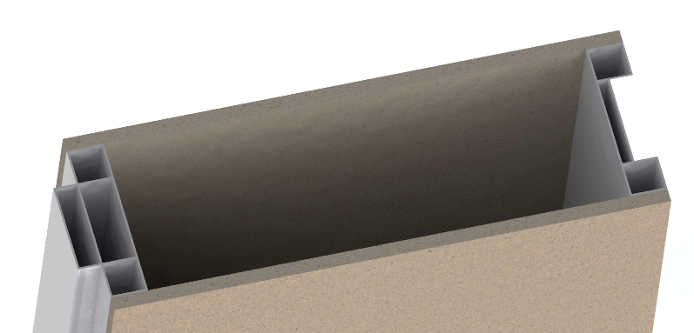
THE PROJECT
Early development
Structural integration and implementation
FINAL DESIGN AND ASSEMBLY
Final panel design
Assembling procedure
PROTOTYPING
Challenges
INTRODUCTION
Structural integration and implementation
PROBLEM: the extrusion process of the profiles removes flexibility to the system and thickness of the panel cannot be fine tuned for less demanding climates.
SOLUTION: Split the whole system and its insulation into 2 panels
2nd premise
FIXED insulation -> 2 layers of 4cm inside (8 cm total)
VARIABLE insulation -> up to 10cm

Slide 10
THE PROJECT
Early development
Structural integration and implementation
FINAL DESIGN AND ASSEMBLY
Final panel design
Assembling procedure
PROTOTYPING
Challenges
INTRODUCTION
Structural integration and implementation
GI Possibilities for the end user
Internal panel only
(U=0,275 W/m.K)*
External panel only (to be connected to existing in-fill)
Both panels
External finishing decided by end user
“Green” aesthetics of the panel;
Thermal performance can be calibrated to each need with the thickening of the exterior insulation
All Green Instructs’ benefits
Green instruct will be a solution for both new construction and rehabilitation markets !!!
Benefits of pre-fabrication
Fast & clean
Enviromentaly friendly thermally effective beautiful facade

Slide 11
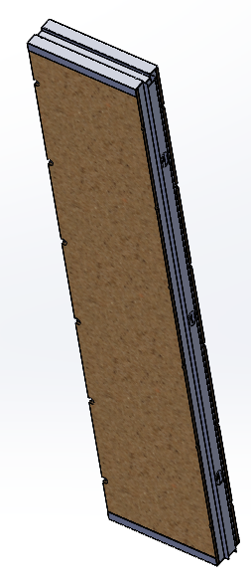
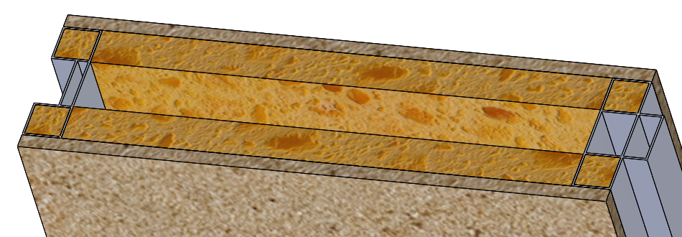
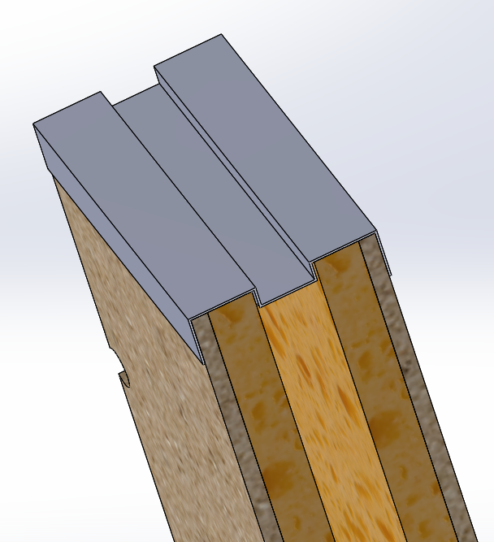
THE PROJECT
Early development
Structural integration and implementation
FINAL DESIGN AND ASSEMBLY
Final panel design
Assembling procedure
PROTOTYPING
Challenges
INTRODUCTION
Structural integration and implementation
Internal panel

Slide 12
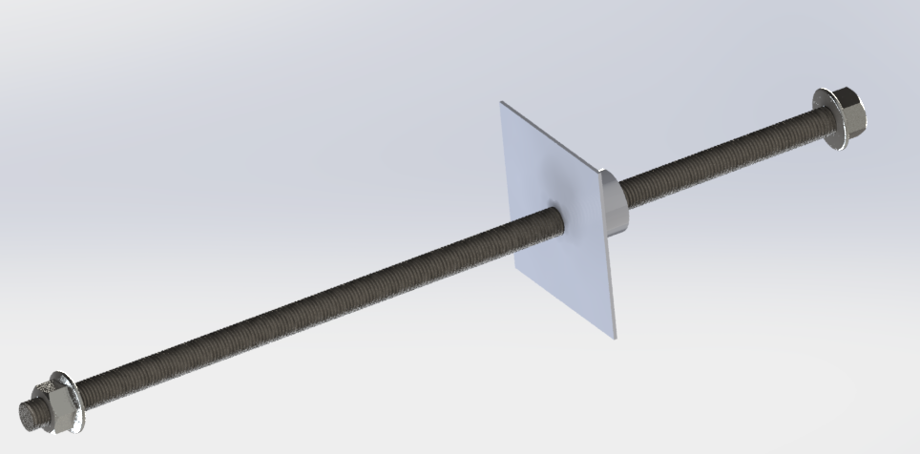
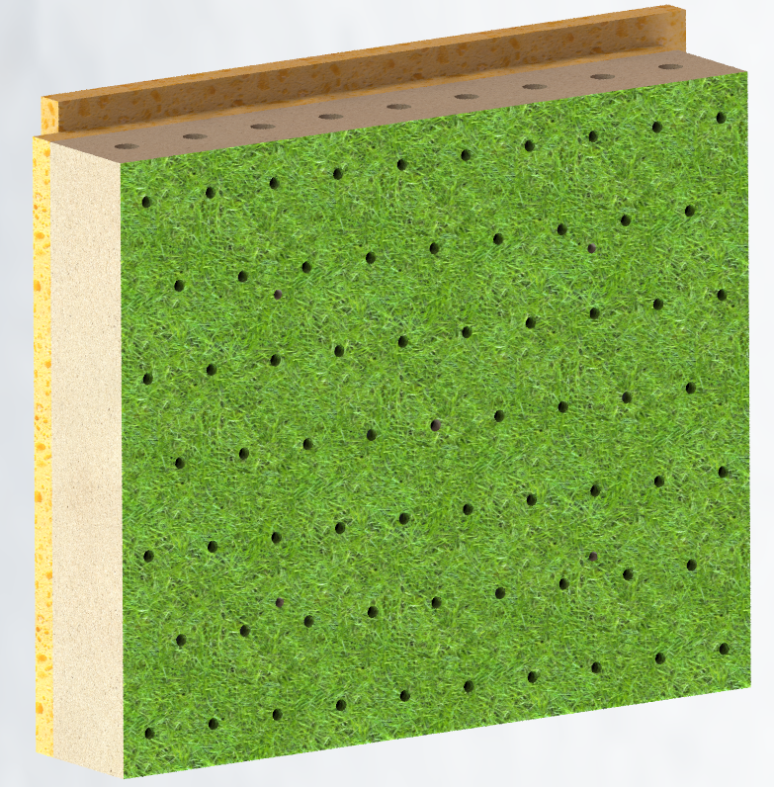
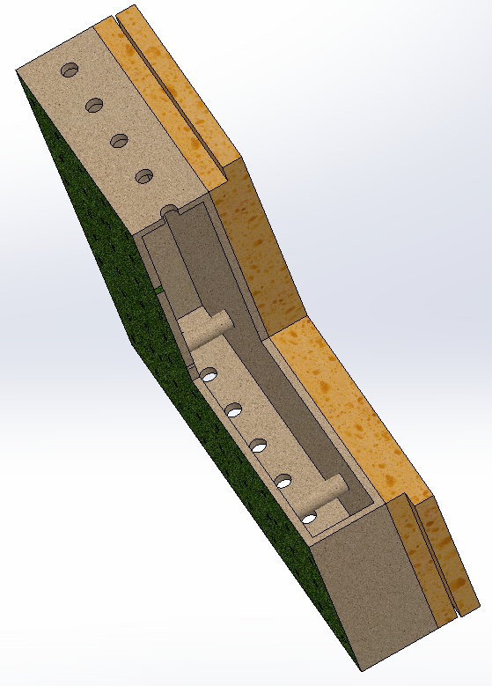
THE PROJECT
Early development
Structural integration and implementation
FINAL DESIGN AND ASSEMBLY
Final panel design
Assembling procedure
PROTOTYPING
Challenges
INTRODUCTION
Structural integration and implementation
External panel

Slide 13
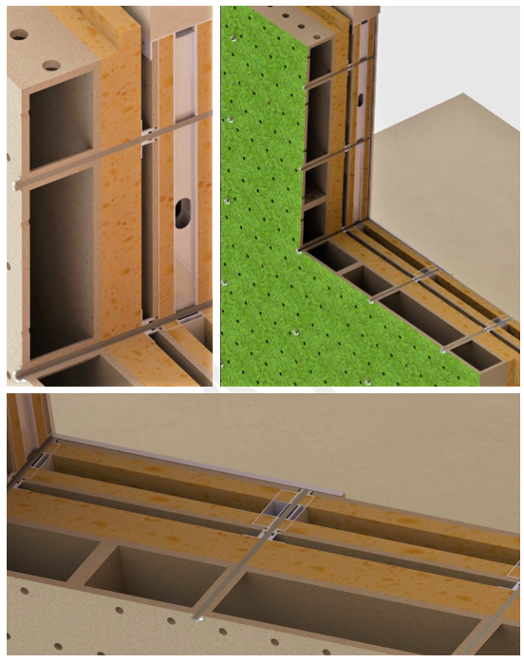
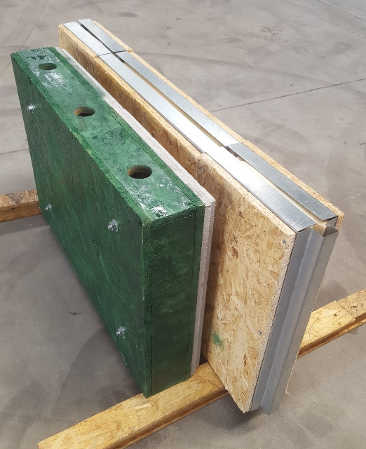
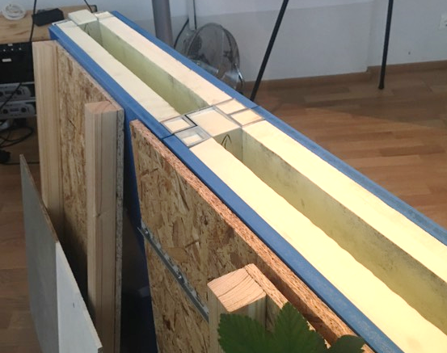
THE PROJECT
Early development
Structural integration and implementation
FINAL DESIGN AND ASSEMBLY
Final panel design
Assembling procedure
PROTOTYPING
Challenges
INTRODUCTION
Structural integration and implementation

Slide 14
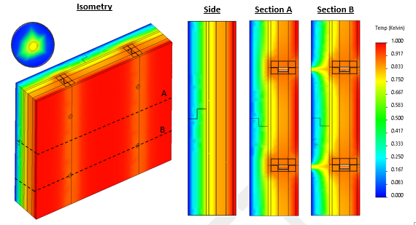
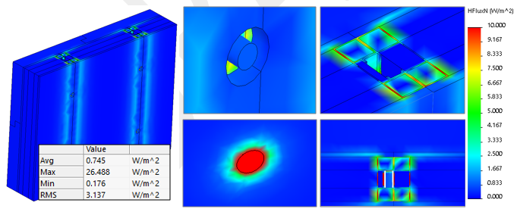
THE PROJECT
Early development
Structural integration and implementation
FINAL DESIGN AND ASSEMBLY
Final panel design
Assembling procedure
PROTOTYPING
Challenges
INTRODUCTION
Challenges
Thermal analyses however revealed several flaws stopping us from reaching the desired U-value of 0,14 W/m.K

Slide 15
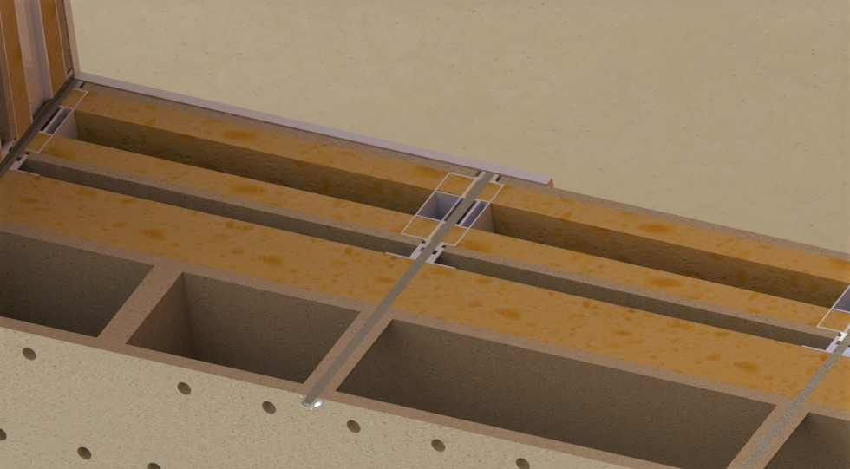
THE PROJECT
Early development
Structural integration and implementation
FINAL DESIGN AND ASSEMBLY
Final panel design
Assembling procedure
PROTOTYPING
Challenges
INTRODUCTION
Challenges
CONCLUSION nº 1
The existence of highly conductive parts throughout the whole thickness of the panel greatly diminishes the internal insulation’s performance!

Slide 16
THE PROJECT
Early development
Structural integration and implementation
FINAL DESIGN AND ASSEMBLY
Final panel design
Assembling procedure
PROTOTYPING
Challenges
INTRODUCTION
Challenges
CONCLUSION nº 2
The existence of highly conductive materials’ parts PIERCING the external insulation greatly diminishes it’s performance!

Slide 17
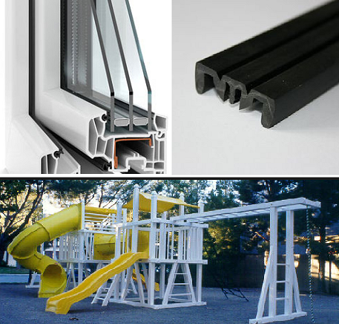
THE PROJECT
Early development
Structural integration and implementation
FINAL DESIGN AND ASSEMBLY
Final panel design
Assembling procedure
PROTOTYPING
Challenges
INTRODUCTION
Final design and assembly
P V C
Remove all the weak aspects that render the insulation layers less viable.
This could be achieved with the placement of an uninterrupted insulation layer throughout the whole sequence of panels.
However, for structural sake, the insulation has to be interrupted.
The solution is to add non conductive materials to the panels’ aluminium skeleton to keep everything solid and stable while not adding too much weight.

Slide 18
THE PROJECT
Early development
Structural integration and implementation
FINAL DESIGN AND ASSEMBLY
Final panel design
Assembling procedure
PROTOTYPING
Challenges
INTRODUCTION
Final panel design
ALU Frame
GEOPolymer
PVC strips
PUFoam
GEOPolymer

Slide 19
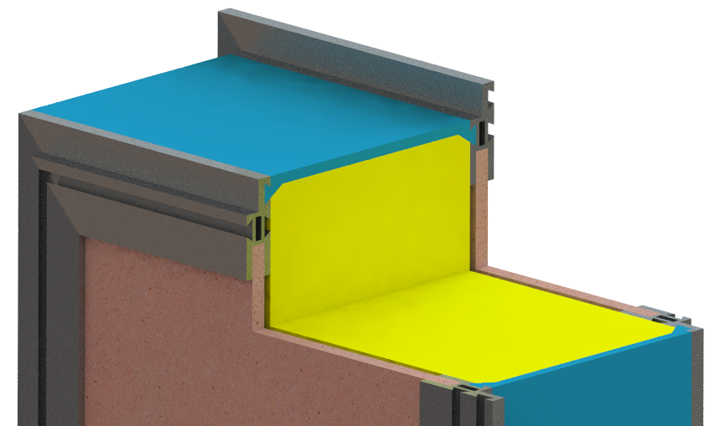
THE PROJECT
Early development
Structural integration and implementation
FINAL DESIGN AND ASSEMBLY
Final panel design
Assembling procedure
PROTOTYPING
Challenges
INTRODUCTION
Final panel design
ALU Frame
PVC strips
PUFoam
GEOPolymer
Continuous tuneable insulation layer interrupted solely by the PVC connection strips minimizing thermal bridge phenomena (λ = 0,159 W/m.K);
Two layers of Geopolymer on each side providing bending stiffness against horizontal perp. to plane actions (e.g. wind, impact);
Highly customizable panel on all dimensions (always the same aluminium profile around the geopolymer layer);
All parts can be produced resorting to extrusion methods, for best competitiveness.

Slide 20
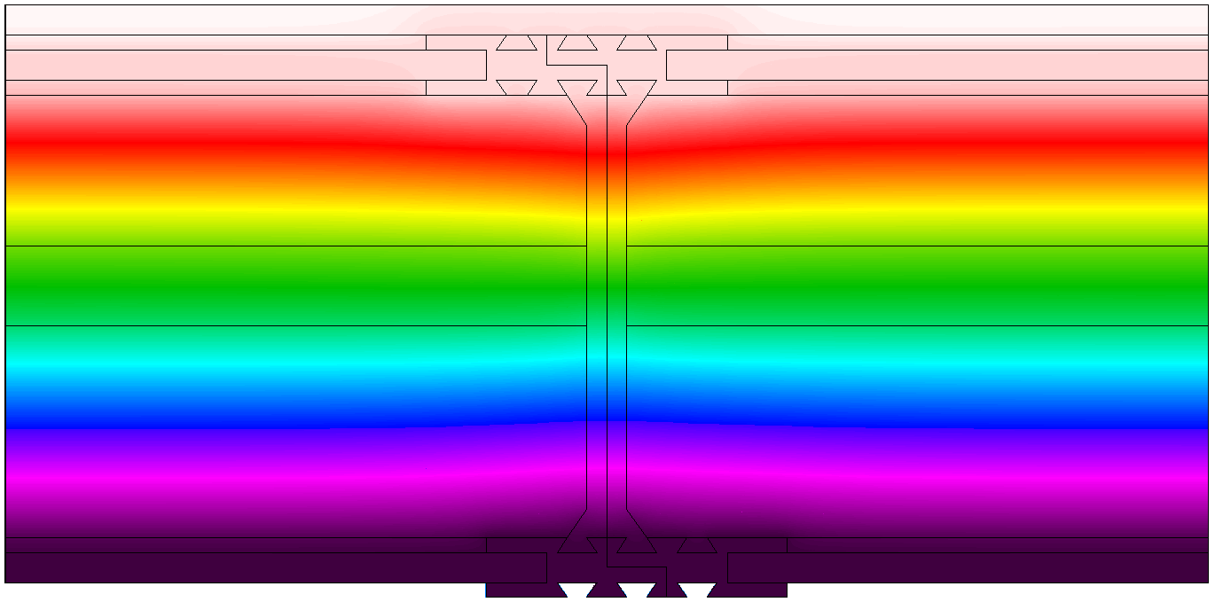
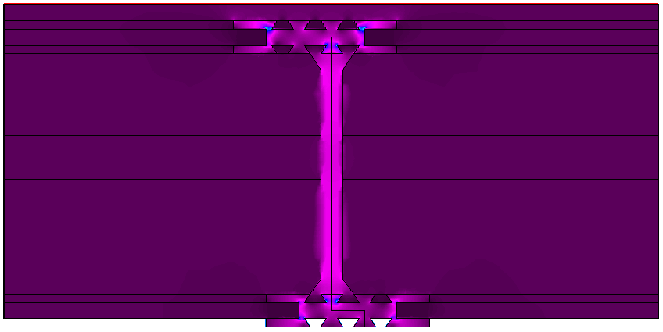
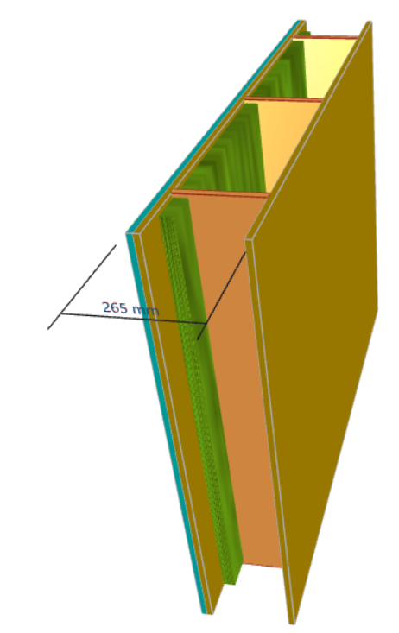
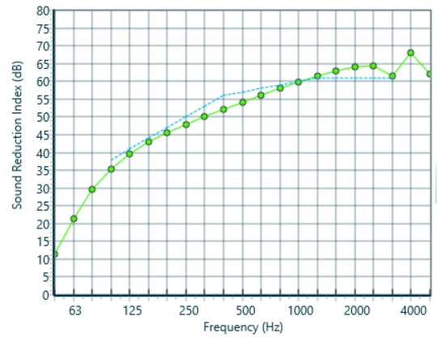
THE PROJECT
Early development
Structural integration and implementation
FINAL DESIGN AND ASSEMBLY
Final panel design
Assembling procedure
PROTOTYPING
Challenges
INTRODUCTION
Thermal Insulation
Temperature [ºC]
Heat Flux [W.m⁻²]
U-Value = 0.14 W.m⁻².ºC⁻¹
Acoustic Insulation

Slide 21
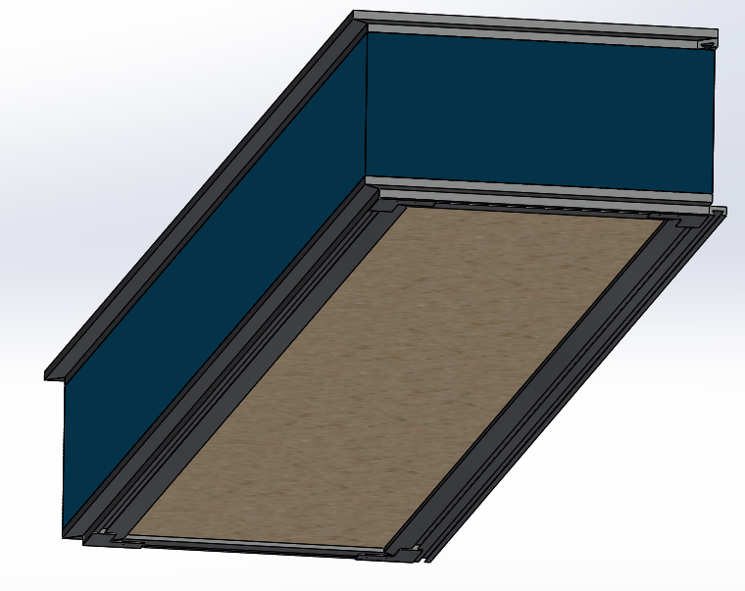
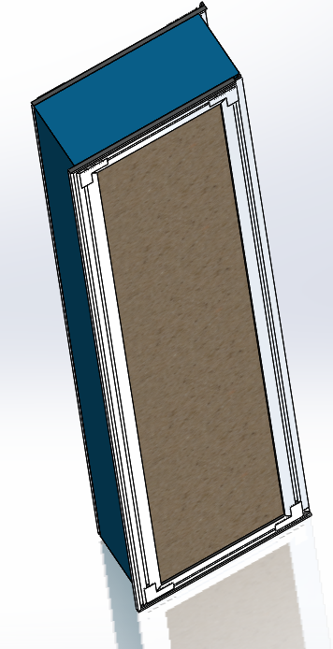
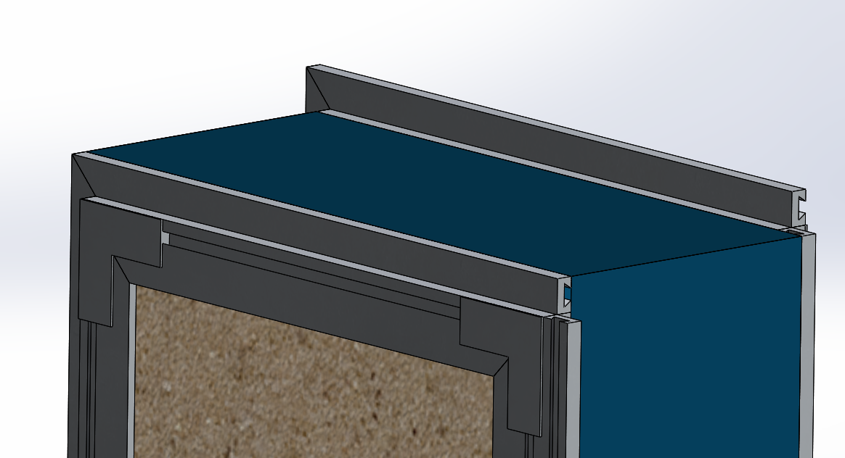
THE PROJECT
Early development
Structural integration and implementation
FINAL DESIGN AND ASSEMBLY
Final panel design
Assembling procedure
PROTOTYPING
Challenges
INTRODUCTION
Internal Panel

Slide 22
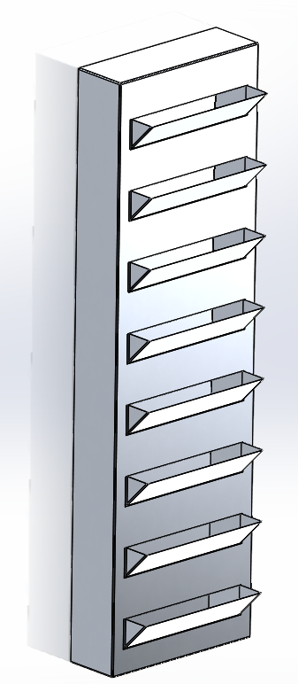
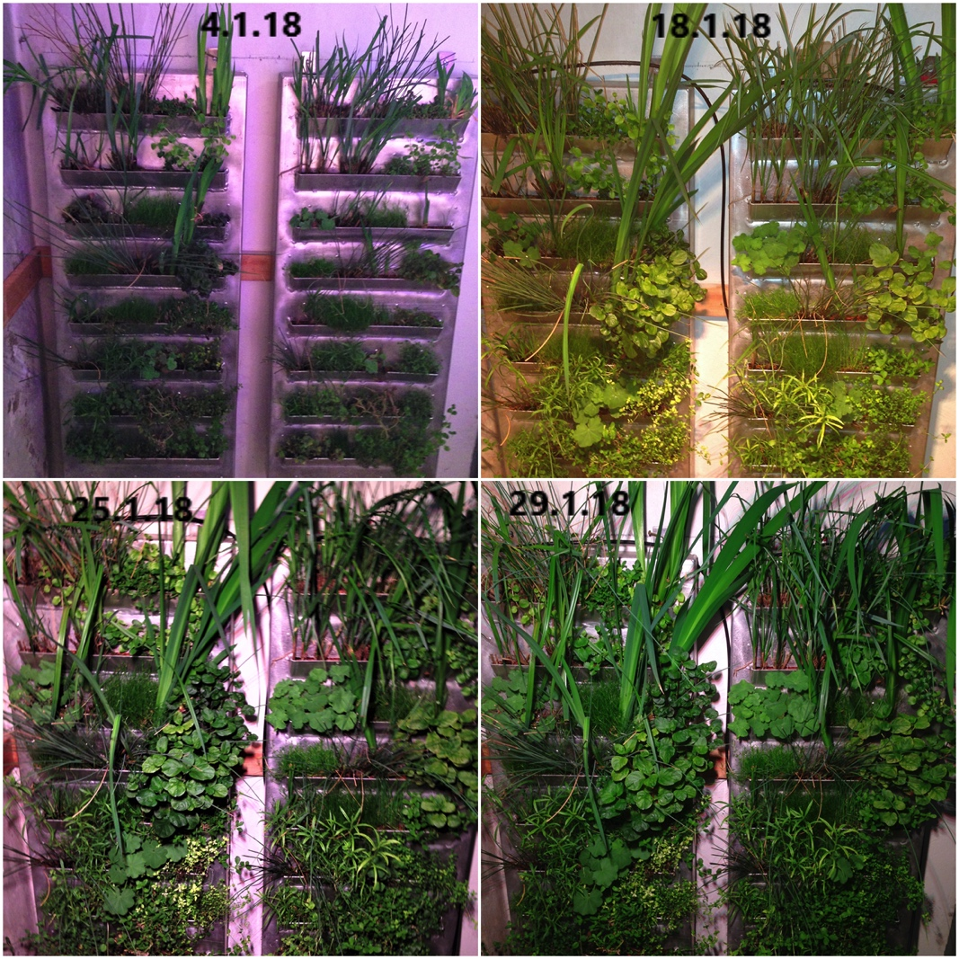
THE PROJECT
Early development
Structural integration and implementation
FINAL DESIGN AND ASSEMBLY
Final panel design
Assembling procedure
PROTOTYPING
Challenges
INTRODUCTION
External panel
Plant growth benchmarks performed by partner alchemia-nova

Slide 23
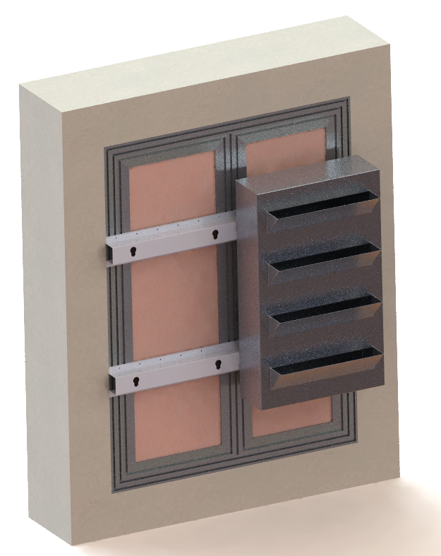
THE PROJECT
Early development
Structural integration and implementation
FINAL DESIGN AND ASSEMBLY
Final panel design
Assembling procedure
PROTOTYPING
Challenges
INTRODUCTION
Assembly procedure

Slide 24
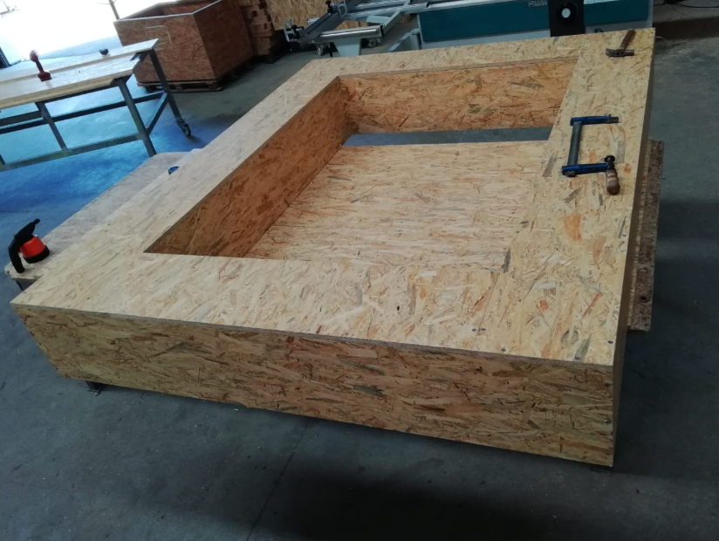
THE PROJECT
Early development
Structural integration and implementation
FINAL DESIGN AND ASSEMBLY
Final panel design
Assembling procedure
PROTOTYPING
Challenges
INTRODUCTION
PROTOTYPING
OSB ENVELOPE – same size as demo-site installations (1,2m x 1,6m)

Slide 25
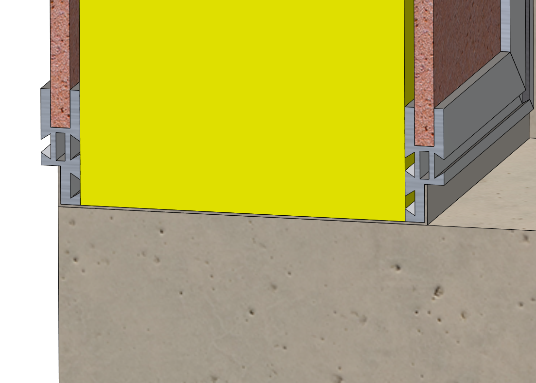
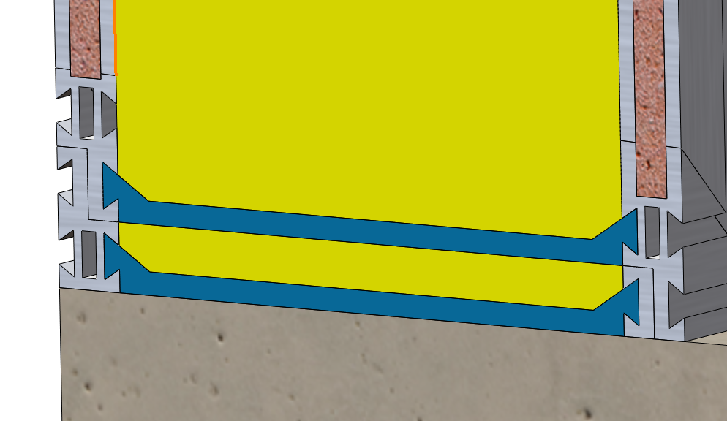
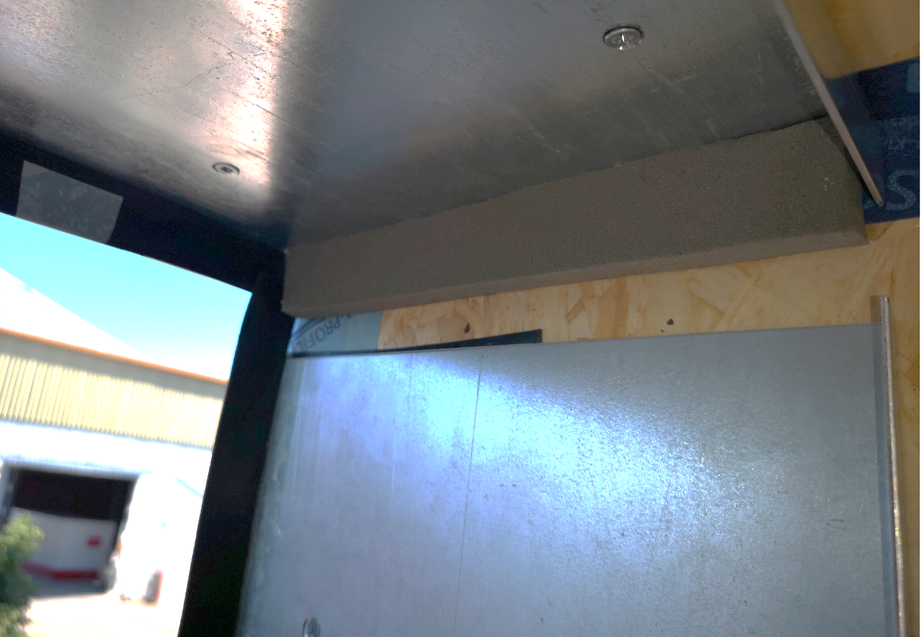
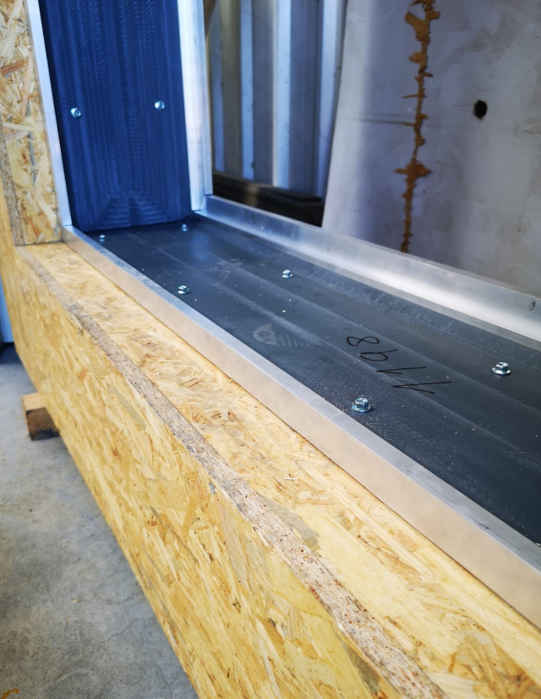
THE PROJECT
Early development
Structural integration and implementation
FINAL DESIGN AND ASSEMBLY
Final panel design
Assembling procedure
PROTOTYPING
Challenges
INTRODUCTION
PROTOTYPING
While tinkering with the prototypes and 3D models, some design changes were tried and the Light version of Green Instruct was invented:
Uses less heavier and expensive material (Aluminium, PVC);
Much easier and faster panel assembly;
Assembly process more flexible to the substrate imperfections (cladding panel);
Overall better competitiveness.
One of the main advantages of Green Instruct is that it is completely modular, and can be fine tuned for any climate, and can further adapt to any material development.
Green Instruct may, one day, have materials that do not yet exist!

Slide 26
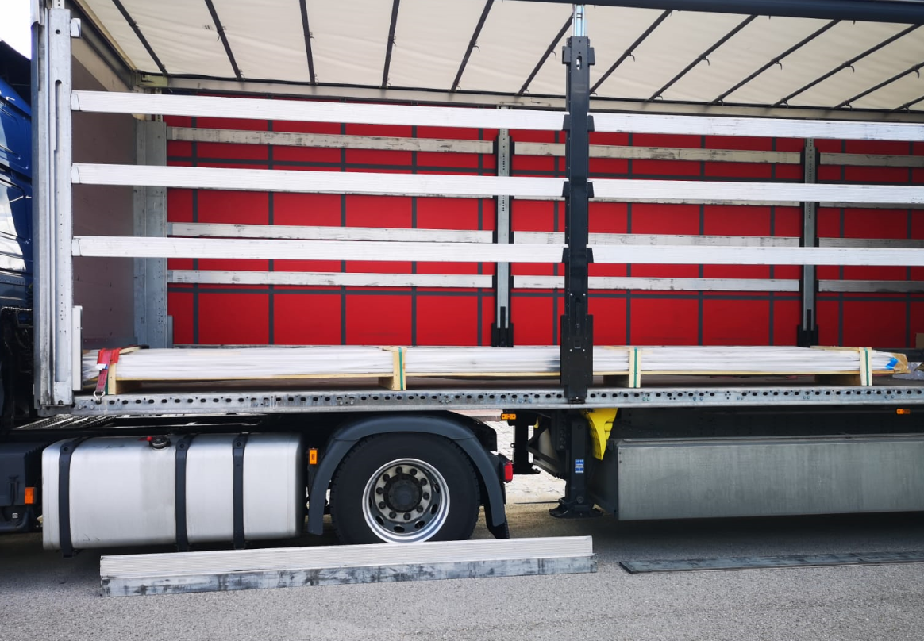
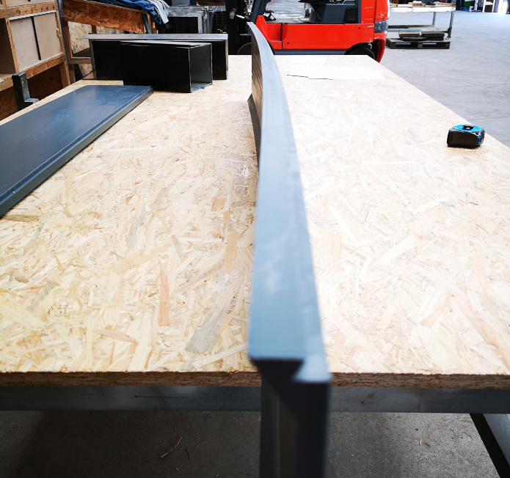
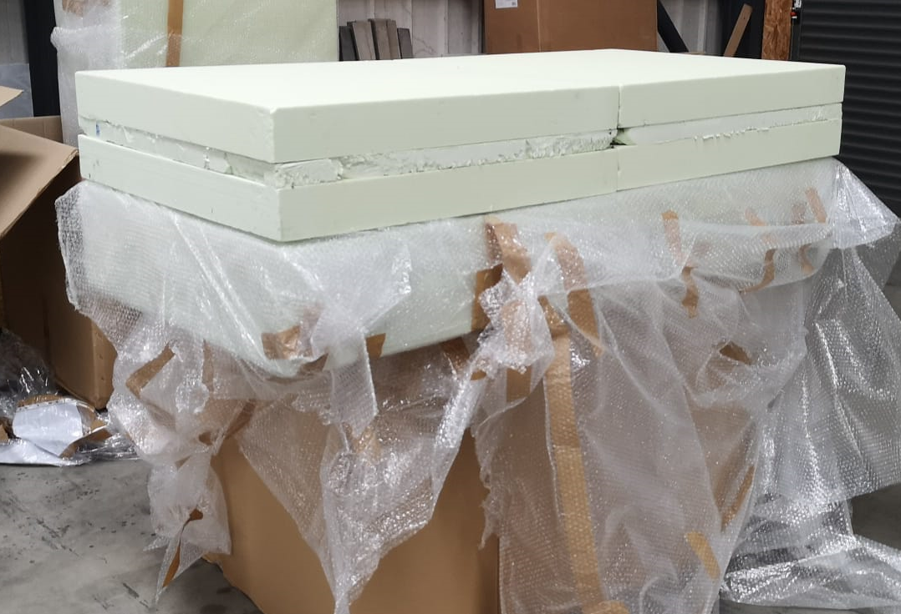
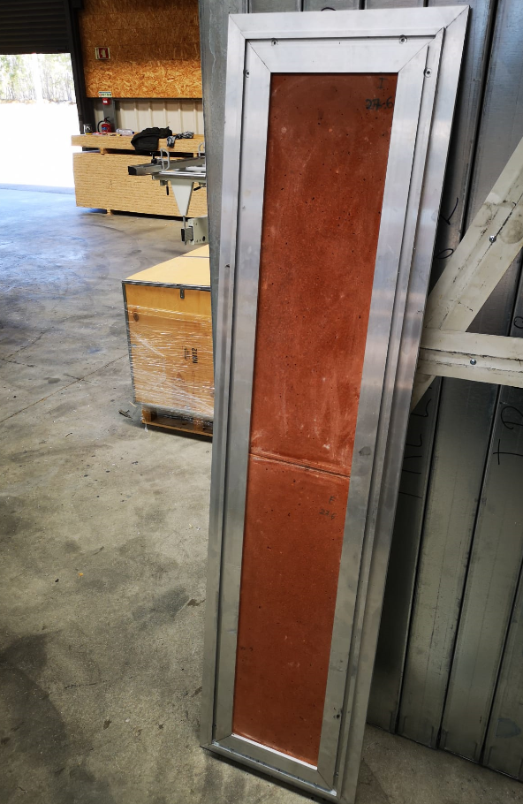
THE PROJECT
Early development
Structural integration and implementation
FINAL DESIGN AND ASSEMBLY
Final panel design
Assembling procedure
PROTOTYPING
Challenges
INTRODUCTION
PROTOTYPING – the parts
Aluminium - Poland
PVC - Portugal
PU Foam - Spain
Geopolymer
Greece / UK
Green wall - Austria

Slide 27
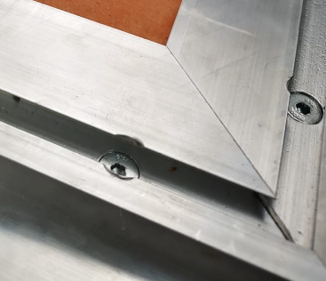
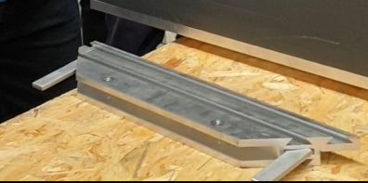
THE PROJECT
Early development
Structural integration and implementation
FINAL DESIGN AND ASSEMBLY
Final panel design
Assembling procedure
PROTOTYPING
Challenges
INTRODUCTION
PROTOTYPING
Steel angles were produced to provide the 90 degree connection between profiles. Threads had to be prepared for connection screws.

Slide 28
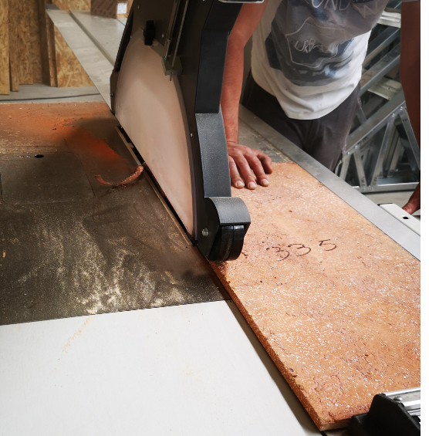
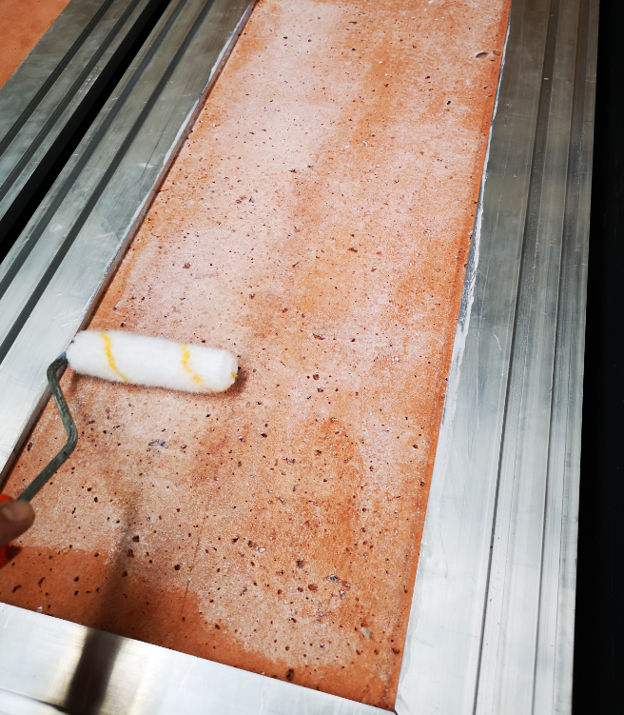
THE PROJECT
Early development
Structural integration and implementation
FINAL DESIGN AND ASSEMBLY
Final panel design
Assembling procedure
PROTOTYPING
Challenges
INTRODUCTION
PROTOTYPING

Slide 29
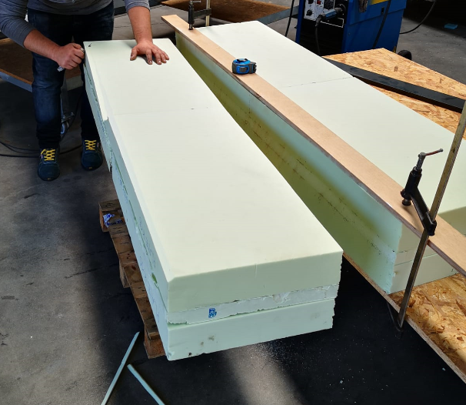
THE PROJECT
Early development
Structural integration and implementation
FINAL DESIGN AND ASSEMBLY
Final panel design
Assembling procedure
PROTOTYPING
Challenges
INTRODUCTION
PROTOTYPING

Slide 30
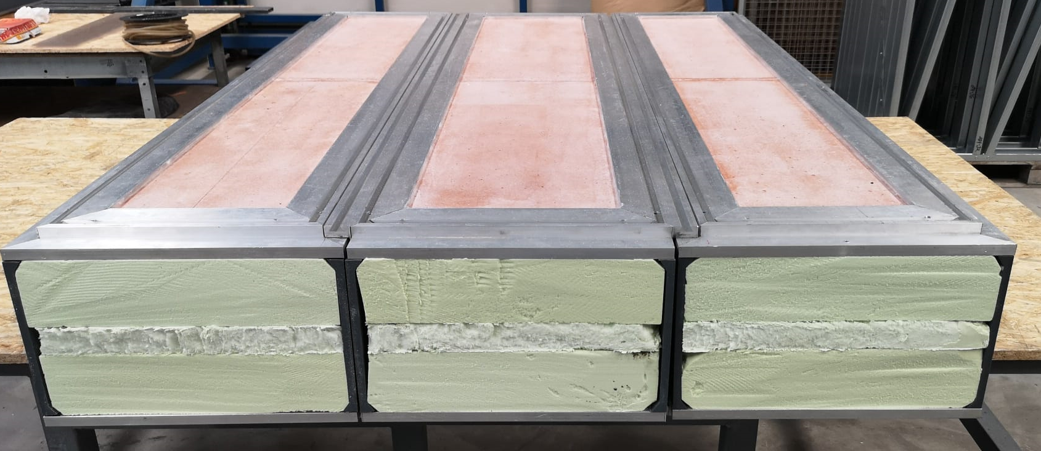
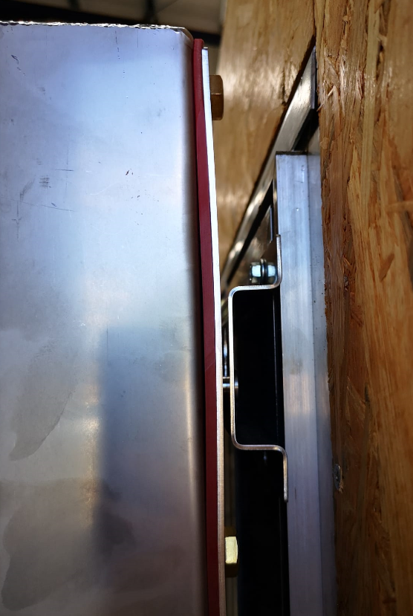
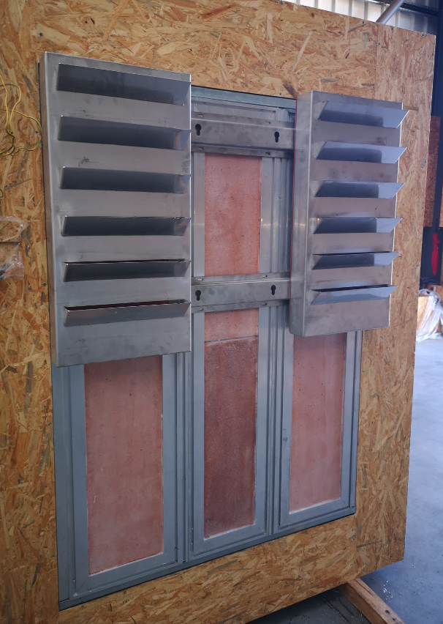
THE PROJECT
Early development
Structural integration and implementation
FINAL DESIGN AND ASSEMBLY
Final panel design
Assembling procedure
PROTOTYPING
Challenges
INTRODUCTION
PROTOTYPING

Slide 31
THE PROJECT
Early development
Structural integration and implementation
FINAL DESIGN AND ASSEMBLY
Final panel design
Assembling procedure
PROTOTYPING
Challenges
INTRODUCTION
PROTOTYPING

Slide 32
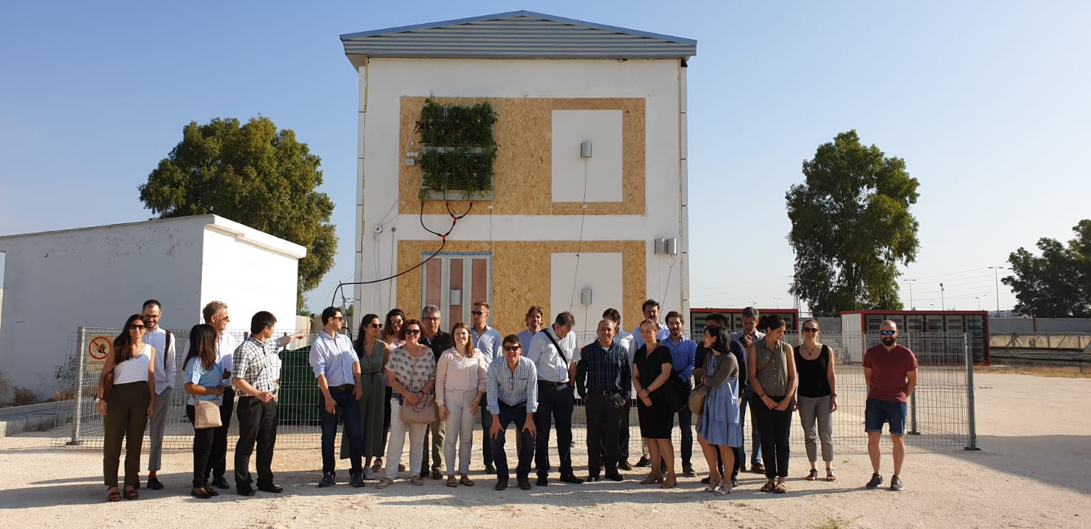
THE PROJECT
Early development
Structural integration and implementation
FINAL DESIGN AND ASSEMBLY
Final panel design
Assembling procedure
PROTOTYPING
Challenges
INTRODUCTION
PROTOTYPING

Slide 33
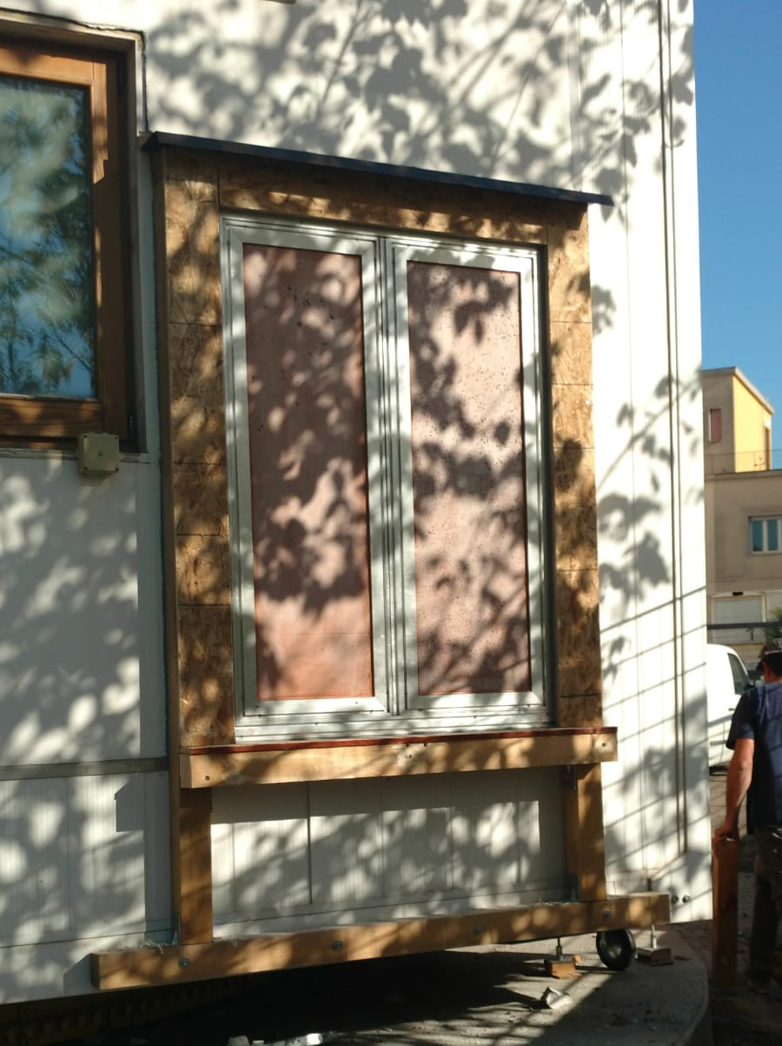
THE PROJECT
Early development
Structural integration and implementation
FINAL DESIGN AND ASSEMBLY
Final panel design
Assembling procedure
PROTOTYPING
Challenges
INTRODUCTION
PROTOTYPING

Slide 34
Thank You For more information : www.greeninstruct.eu

